Slide 1
Federation of Piling Specialists
Toolbox Talks

Slide 2
Contents
01: Piling Processes.
01/01 CFA Piling
01/02 Concrete Pumping
01/03 Compressed Air
01/04 Driven Piling
01/05 Flame Cutting
01/06 Reinforcement & Pile Cages
01/07 Rotary Bored Piling
01/08 Drop Hammer Mini-Piling
01/09 Use of PFA
01/10 Ground Anchors & Soil Nails
01/11 Diaphragm & Slurry Walling
01/12 Pre-Cast Concrete Piling
01/13 Pile Load Testing – Tension Piles
01/14 Pile Load Testing - Kentledge
01/15 Pile Integrity Testing
01/16 Vibroflotation
01/17 Bentonite
01/18 Cleaning Stop Ends
01/19 Bored Mini-Piling
01/20 SFA Mini-Piling
01/21 Displacement Piling
02: Plant and Equipment.
02/01 Abrasive Wheels
02/02 Dumpers & Site Vehicles
02/03 Use of Hand Tools
02/04 Lifting Equipment & Lifting Accessories
02/05 Excavators & Wheeled Loaders.
02/06 Banksmen & Site Plant
02: Plant and Equipment. (Contd.)
02/07 Ready Mix Concrete Trucks
02/08 Tower Lights
02/09 Use of Fabric Slings
02/10 Single Trip Slings
02/11 Handling Rebar Cages
02/12 MEWPs
02/13 Concrete Hoses
02/14 Piling Rigs
02/15 Grout Pumps
02/16 Lorry Loaders
02/17 Telehandlers
02/18 Cranes
02/19 Jet Washers
02/20 Manriders
03: Workplace.
03/01 Housekeeping
03/02 Working at Height
03/03 Working Platforms
03/04 Working Near Water
03/05 Works Near Motorways & Trunk Roads
03/06 Works Near Railway Lines
03/07 Electrical Equipment on Site
03/08 Overhead Electric Services
03/09 Underground Services
03/10 Restricted Working Space
03/11 Property Protection/Security/Third Party Protection
03/12 Storage & Stacking of Casings / Cages
03/13 Slinging & Signalling
03: Workplace (Contd.)
03/14 Flammable Liquids & Gases
03/15 Permit to Work Systems
03/16 PPE
03/17 Fall Arrest Systems
03/18 Pre-start checks
04: Occupational Health.
04/01 COSHH
04/02 Protecting Hands & Feet
04/03 Personal Hygiene
04/04 Manual Handling
04/05 Skin Diseases
04/06 Working in Confined Spaces
04/07 H.A.V.S.
04/08 Drugs & Alcohol
04/09 Hot Weather
04/10 Cold Weather
04/11 Noise
05: Environment.
05/01 Protecting our Environment
05/02 Contaminated Land
05/03 Environmental Noise & Vibration
05/04 Water & Ground Pollution
05/05 Emissions & Air Quality
05/06 Waste Minimisation & Sustainability
05/07 Asbestos
05/08 Fuel Storage
05/09 Spill Control
05/10 Waste Management

Slide 3
Contents
06: Yard.
06/01 Hand Tools
06/02 Loading & Unloading Rigs and Cranes
06/03 Paint Shop
06/04 Plant Maintenance
06/05 Steam Cleaning
06/06 Gantry Cranes
06/07 Cutting & Welding
06/08 Unloading Equipment
06/09 Machine Guards
06/10 Dust
07: Office
07/01 Fire Safety
07/02 Accident & Near Miss Reporting
07/03 Use of Computers (DSE)
07/04 Manual Handling
07/05 Slips, Trips & Falls
07/06 Driving
07/07 Housekeeping
07/08 Environment/ Sustainability
07/09 Electrical Safety
07/10 Non – Conformance Reporting
07/11 Workplace Stress

Slide 4
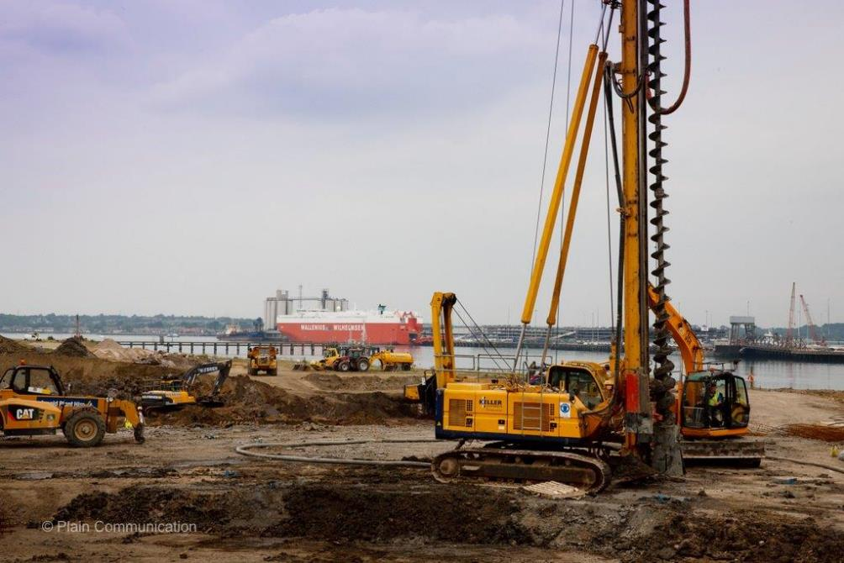
CFA Piling
All operators must be competent, trained and authorised to operate the equipment.
A Working Platform Certificate needs to signed by the client before the rig is rigged up.
The rig must not be moved without a banksman/Rig Attendant present.
The Banksman/ Rig Attendant when banking the piling rig must use clear recognized hand signals.
When rigging up the Rig Driver plus at least one other person must be present.
Make sure all pins are secured in the mast and tracks.
When installing the extension bar leave in open position as long as possible while attaching the auger string and always rotate the drill head in a forwards spin direction.
When putting the hose together always use appropriate clamps and rubbers and secure using a clevis pin.
When putting together an auger string use a MEWP/ ladder and make sure the auger pins are secure.
Never let the spoil on the auger go above the cleaner height. If the auger cleaner is not working stop & inform your supervisor.
Any missing auger cleaner brushes must be replaced.
If the rig driver leaves the rig he must switch off the engine and take the key.
When removing auger teeth and auger pins a copper ended hammer should be used.
Make sure the auger has stopped rotating before opening the gates.
All lifting gear must be tested 6 monthly and have the correct markings, the right documentation for the lifting equipment must be kept in the rig.
At the end of all shifts the auger should be positioned on the ground.
Q. What should be in place before rigging up commences?
Q. When removing auger teeth and pins which sort of hammer should be used?
Q. How offend should the lifting equipment be tested?
Tool Box Talk No: 01/01

Slide 5
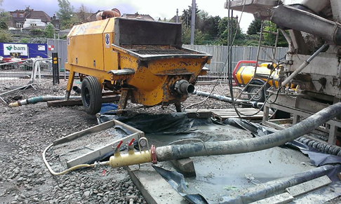
Concrete Pumping
Do not operate a pump unless you are competent, trained and authorised to do so.
Pump operators must wear goggles/Safety Glasses and rubber gloves to protect themselves from concrete splashes.
Concrete Burns if it comes in contact with your skin wash off immediately.
Ear protection must be worn when working around the pump and holding drum.
Slip, Trips and falls causes the most accidents on site, make sure the pumping area is kept clear and unobstructed at all times.
Before starting work make sure all emergency stops are working correctly. If not inform your Supervisor.
Protect all drains, streams and other waterways from pollution.
Inspect concrete hoses daily to make sure that all concrete clamps are secured with a safety pin and the hoses are clear from braiding. If braiding is exposed seek advise immediately.
Always wash out the blow out gun to keep it in good working order at the end of a shift.
Fit a catch basket to the discharge end of the pipe before discharge commences.
A concrete pump produces up to 66 bar in pressure, when new a hoses is tested at 100 bar, by make sure no site traffic run over the placement hose, you will help stop an incident in the future.
When pipe lines are being ‘blown out’ keep people away from the discharge end.
If the line becomes blocked stop immediately and seek direction from the foreman.
Always release the pressure by reverse pumping before opening pipe couplings.
Pumps should be located with a mind to safe access for concrete lorries.
Concrete lorries should be banked up to the concrete pump making sure you are always visible to the driver as he reverses.
When standing in the crows nest on a holding drum make sure access chain is in place.
Q. Why should you protect drains?
Q. Concrete does what?
Q. What pressure does a pump work at?
Tool Box Talk No: 01/02

Slide 6
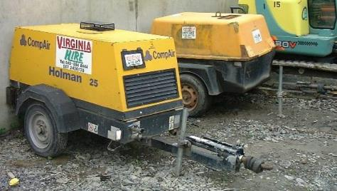
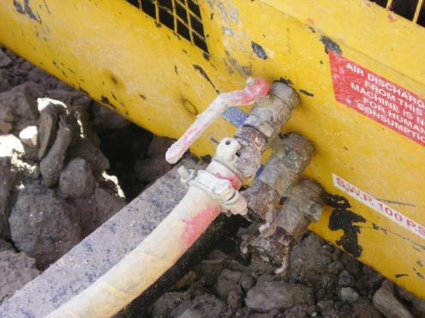
Compressed Air
Compressors are a common site on most construction sites and are used for many different activities
Compressed air must not be used for any purpose other than that which it is intended for.
Compressed air should never be directed towards any person – it can cause serious injuries.
Always ensure that the pressure in the lines has been relieved prior to breaking joints. Shut off the air supply and bleed the line from the tool end prior to disconnecting.
Check all connections are the safety clip type and whip checks have been placed at every joint, compressor to airline, airline to airline and airline to tool.
Check hoses and joints are clean and free from moisture prior to use
If ear or eye protection is necessary make sure it is worn.
Do not leave hoses lying around and keep hose lengths to a minimum to reduce tripping hazards.
Keep all personnel not directly involved in the activity away from the work area.
If any repairs are required ensure they are carried out by a competent person and to an acceptable standard. Do not try to repair or re-end damaged hose.
Ensure access/egress is kept clear of hoses wherever possible. Set up compressor such that there is access around the machine.
Keep compressor clean and ensure that the hitch, stand and brakes are in good order.
Q. What should you do before breaking joints?
Q. Why should you keep hose lengths to a minimum ?
Q. Where should you bleed the air supply from?
Tool Box Talk No: 01/03

Slide 7
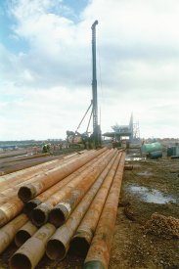
Driven Piling
‘Driven’ refers to any hammer driven piling operation.
Driven piling has some hazards that are different from other piling techniques because of the type of machinery that is used.
Always keep clear of any loads being hoisted
Keep hands and feet clear when pitching piles
Never work under a suspended hammer unless it is resting on the hammer stops
Wear eye protection when plumbing, setting rake or taking sets on concrete piles to prevent concrete flakes getting in your eyes
Make sure the driver knows where you are at all times
Always use a safety harness when working at height
All plant movements should be done under the supervision of a competent banksman
Any exposed rebar, such as setting out pins, must have protection caps
Check all lifting equipment before using it.
Ensure that any smoldering timber packings do not catch fire
Always use a wire sling when pitching piles, never use the lifting eye alone.
Q. What must you do when pitching piles?
Q. When should you wear eye protection?
Q. When should a banksman be present?
Tool Box Talk No: 01/04

Slide 8
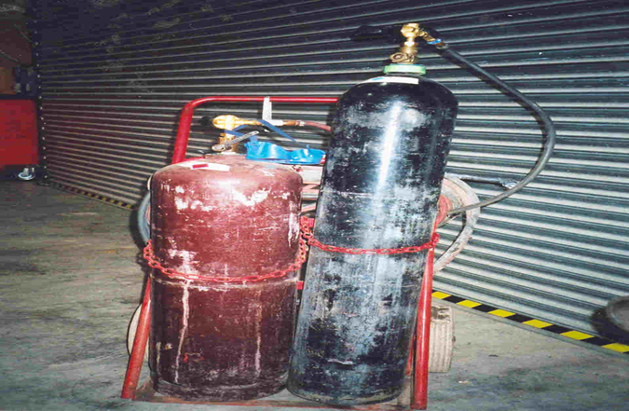
Flame Cutting
Much about using the equipment safely depends on good preparation:
Flame cutting using oxy-acetylene or propane-oxygen is a fast way to cut steel, but it can only be carried out by trained personnel.
You will need to have a Hot Work Permit issued before you commence.
Gas bottles must only be moved around the site in a purpose made lifting frame. Do not use a crane to lift a bottle trolley.
Do not roll cylinders.
Ensure your equipment is in good condition, e.g., hoses, valves, torch. Ensure all hose fittings are crimped, flashback arrestors are in place on bottles and non return valves on the torch.
Always use the fuel gas cylinder in an upright secure position.
An appropriate fire extinguisher must be present.
Always follow the correct purging and lighting procedure.
Always ensure you are wearing the correct PPE.
At the end of the shift, ensure all lines are empty and cylinder valves are closed.
Cylinders must be stored correctly in a ventilated cage, upright and secure.
Separate gas and oxygen cylinders, also full and empties. Keep them 3m apart.
Q. What must be issued before you commence work?
Q. How should the fuel gas cylinder be used?
Q. How far apart should gas and oxygen cylinders be separated?
Tool Box Talk No: 01/05

Slide 9
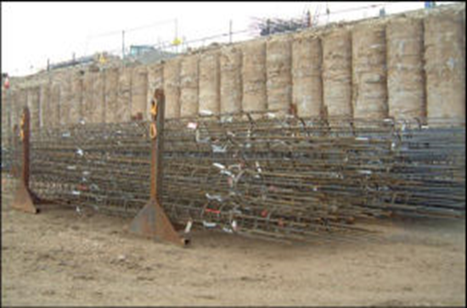
Reinforcement & Pile Cages
When off loading or stacking reinforcement (either bars or cages) ensure its stability. Never use the banding or binding wire to lift bundles of steel or cages.
Always stack cages/bars on timber or in trestles. This not only keeps the steel clean but it makes it easier to sling.
Wear gloves when handling bars/cages, this will help prevent you getting cuts.
Do not attempt to lift heavy bars on your own. Follow manual handling procedures.
Make sure tying wire is bent back into cages if it is used, this will help prevent people cutting themselves on it.
Don’t leave tying wire lying around the floor, either you, or someone else will trip over it.
Use appropriate lifting accessories attached to lifting points when moving/placing cages.
Use tag lines where necessary and keep cage/bar as close to the ground as possible when lifting with a crane.
Keep fingers and feet out of the way when lowering loads.
If you are cutting or welding bars/cages make sure you wear appropriate eye protection and ensure the area is clear of flammable materials.
The helical on pre-fabricated cages can be very ‘springy’ if for any reason you need to cut helical on site you should make sure a bulldog grip or tying wire is used to hold the helical in place while you are cutting it.
Some spacers/cage formers should only be tightened with torque wrenches. If you are using these types make sure you have a torque wrench available and that you know how to use it.
Q. What should you not use banding for?
Q. Where should you leave tying wire?
Q. What should you do when cutting helical?
Tool Box Talk No: 01/06

Slide 10
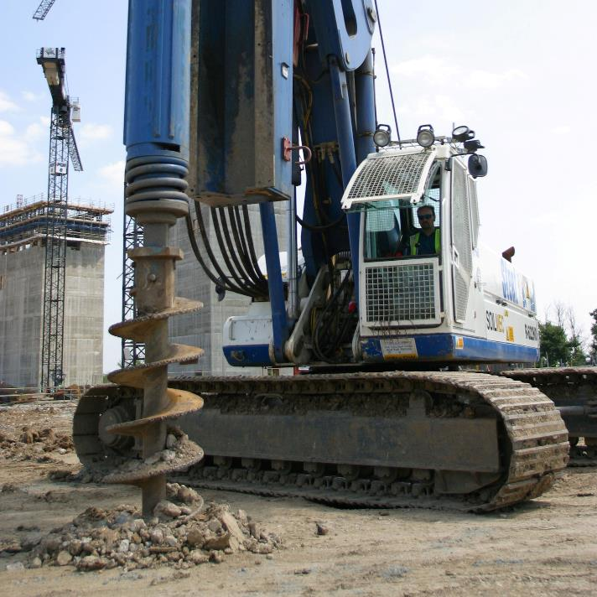
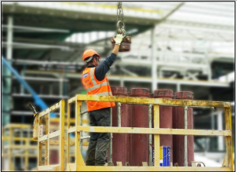
Rotary Bored Piling
Always ensure rig is working on a firm, level platform.
Make sure a permit to work and a platform certificate is in place before commencing work.
Use two off sets at 90° and monitor till auger has drilled in to solid material.
An exclusion zone must be maintained with barriers and no entry signage along the slew arc of the rig.
Always stand outside the exclusion zone when the rig is drilling or discharging spoil.
Keep spoil as far away as possible from the borehole.
Maintain good access for pedestrians and vehicles.
Insert a temporary casing as soon as possible to prevent collapse of the bore and to provide edge protection.
Always use ‘r’ type clips to secure pins.
Keep away from open bore holes – cover and/or barrier off.
Keep fingers and feet clear of loads and out of moving parts.
Ensure cages are slung correctly, do not put hands or arms inside the cage when splicing over the bore.
Check all lifting accessories prior to use. If defective take out of use and attach a red do not use tag to the lifting accessories and inform your Supervisor.
All reversing vehicles should have a banksman in attendance (this includes concrete wagons and muckaway wagons)
If a ‘pinch point’ is identified it must be barriered off. A pinch point is an area where there is a gap of less than 600mm between the rig/crane and an immovable object.
Make sure all open bores are back filled with a granular material and monitored for slumping. Barrier off any that are found to off slumped and inform the Operations Supervisor.
A Pre-inspection sheet of the piling rig must be completed daily by a competent person and email to the office.
Q. Where should you stand when the rig is discharging spoil?
Q. What should you do to open bore holes?
Q. What should be along the slew arc of the rig?
Tool
Tool Box Talk No: 01/07

Slide 11
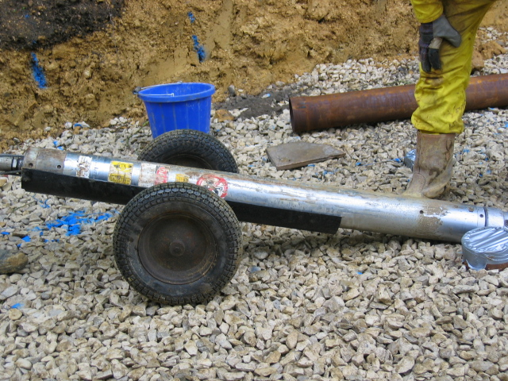
Drop Hammer Mini-Piling
Stability
Drop-hammer rigs can be unstable as they are “top-heavy”. You must not allow the rig to be more that 6” (150mm) off vertical and the rig must be stabilised
Manual handling and Lifting
The rig components are heavy and should not be lifted unaided.Operatives must:
Pick up in pairs
Offload lorry with tail-lift or crane
Use the transport wheels or “gun carriage”
The work area must be inspected and prepared before moving the rig into position. Check the rig can be stabilised.
Inspect for hydraulic leaks after connecting the power-pack, before starting driving.
The raised hammer has a “no go zone” under it. Keep hands and feet clear.
Q. Why must a drop-hammer mini-rig be stabilised?
Q. What precautions do you take to avoid manual handling injuries?
Q. Why is there a “no-go” zone under the hammer?
Tool Box Talk No: 01/08

Slide 12
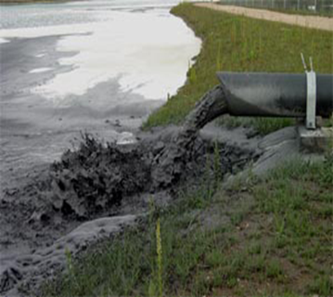
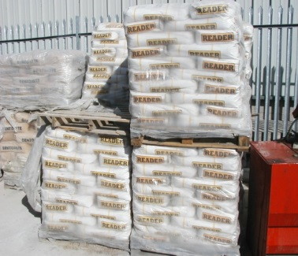
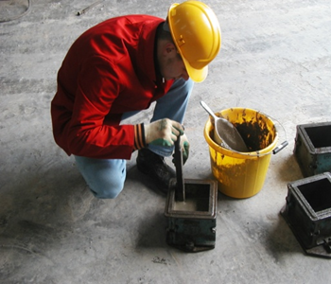
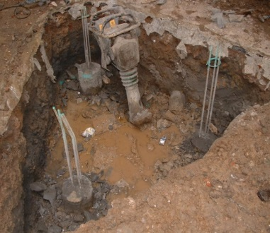
Use of PFA
Pulverised Fuel Ash (PFA)is also known as fly ash. It is a by product of pulverised coal used in today's power stations. Fine ash is filtered from the gas flue of the burners and collected in large holding lagoons.
Being a by product it acts as a very good alternative to the ever decreasing stock pile of aggregates.
Product Uses
Used in ready mixed concrete, concrete products and block manufacture.
Used for grouting, filling voids in the ground e.g. mine shafts and around obstacles in the ground being self levelling it will fill all voids.
being light weight its ideal for road sub bases
Used in piling, mixed with cement can be injected through the augers to aid the formation of a pile
Can be used as a bulk powder or in individual 25 kilo bags
Additional Personal Protection Required
Eye Protection –dry powder (blown dust) wet solution (splashes)to conform with EN BS 166
Breathing Protection-dry powder (blown dust) to conform with EN BS 149
Hand Protection- dermatitis, chemical burns
Hazards
Chemical reaction with cement can cause “cement burns”
Inhalation of Grout dust can cause major respiratory problems
Particles of grout dust in the eye can cause loss of sight
WEAR YOUR P.P.E.
PROTECT YOURSELF
FROM THIS
TO THIS
TO THIS
TO THIS
Tool Box Talk No: 01/09

Slide 13
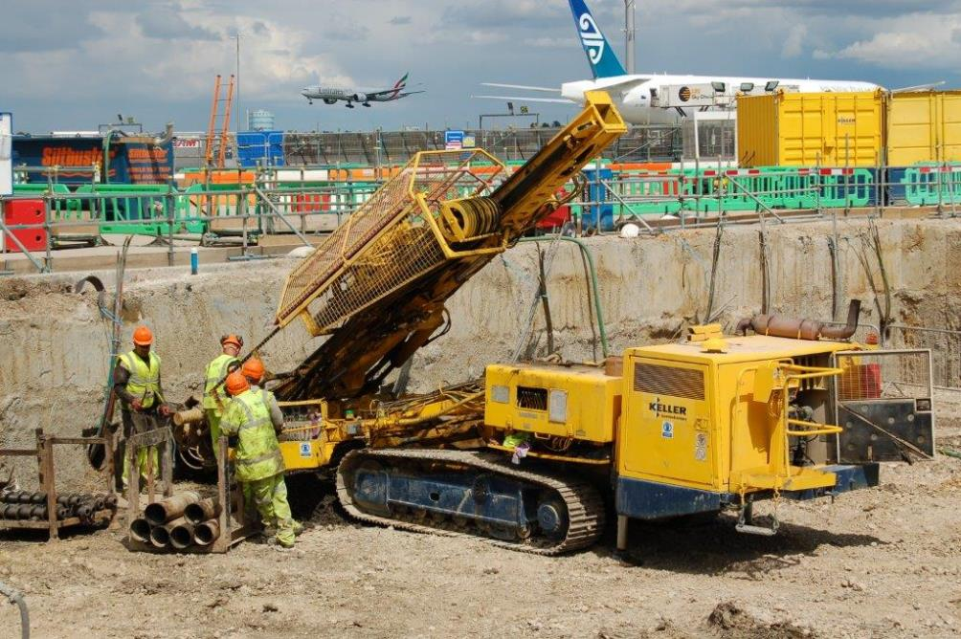
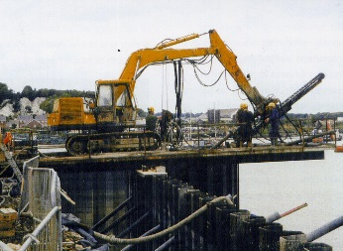
Ground Anchors & Soil Nails
Anchors should be stored on a purpose made anchor frame.
The anchor frame should be positioned as close to the place of installation
If manual handling of anchors is unavoidable, then sufficient labour should be provided, and the route to be taken should be free of obstructions.
When stressing anchors the working platform shall be firm and dry to allow for the safe movement of the stressing jack.
The stressing team shall not stand in front of the anchor being tested.
All tools and equipment should be tied and attached to anchor points within any access platform.
Access platforms should have hand rails on all boundaries. The entrance gate should open inwards and have a locking device.
When stressing anchors, an area of 5 m² should be cordoned off around the anchor.
Q. Apart from anchor/nail risks, what other general risk can you see in the picture?
Tool Box Talk No: 01/10

Slide 14
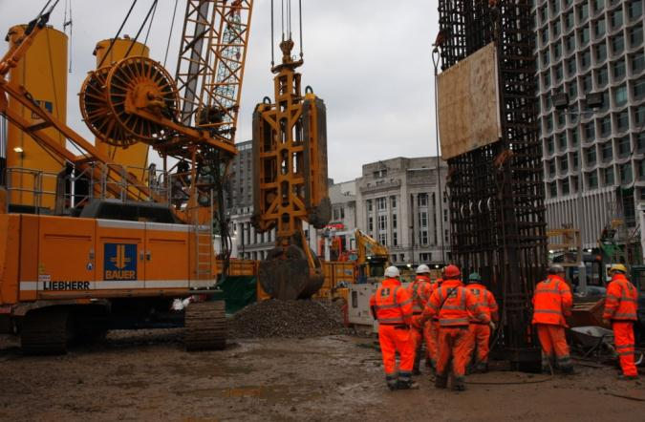
Diaphragm & Slurry Walls
Always ensure the rig and plant are working on firm, level and certified platforms.
Obtain a permit to excavate before beginning work.
A controlled zone must be established. This is defined as the area around the slew area at the back of the rig, includes the excavation and around the spoil heap. From the front of the rig the zone extends beyond the excavation and spoil heap by two metres. Only the Banksman is normally allowed into the controlled zone and he will supervise any other persons who need to enter.
The Banksman in charge of the controlled zone must be a trained Slinger / Signaller and have received a minimum of one day’s safety training in the last 12 months. He should be clearly identifiable.
Ensure the excavation is clearly marked and supervised at all times. Always protect if left unattended.
Keep the excavation perimeter tidy and clear of all trip hazards.
Stand well clear of the excavation plant when digging or discharging spoil.
Maintain good access to and from the excavation at all times.
Lifting of reinforcement cages must be to an approved method statement and under the supervision of an Approved Person.
Always use the correct ropes, slings and shackles, suitably certified. Inspect frequently and replace if necessary.
Stand clear of the excavation as the cage is lowered into position.
Keep the work area clean and tidy, wash any bentonite slurry back into trench.
Maintain edge protection if reversing concrete wagons towards the excavation. Wagons should only reverse under the supervision of a suitably qualified banksman.
Protect any projecting rebar with ‘mushroom caps’ or similar.
Ensure the trench is adequately covered until the concrete / slurry is hard. Continue to demarcate the trench edge.
Q. What should you obtain before beginning work?
Q. What should be provided at the excavation edge?
Tool Box Talk No: 01/11

Slide 15
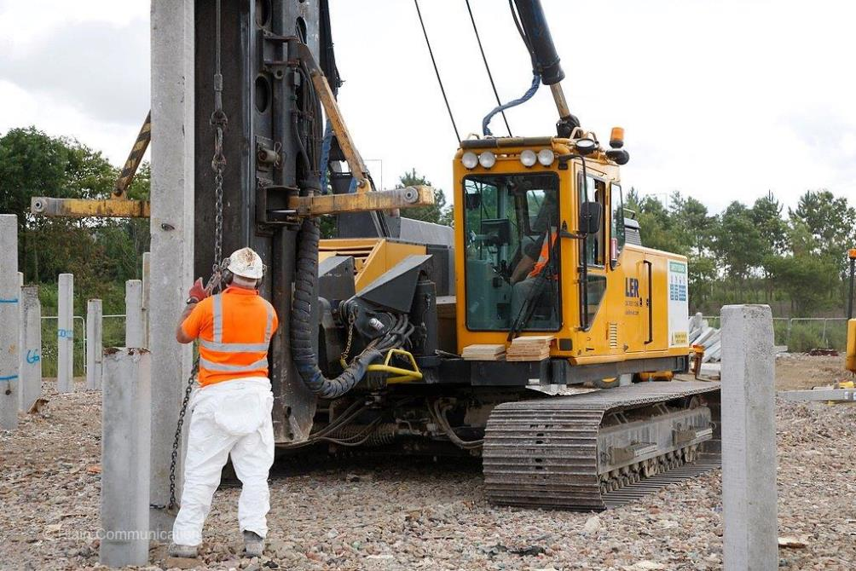
Pre-Cast Concrete Piling
With this type of piling, precast-concrete columns are driven into the ground using a piling hammer.
Precast concrete piles are called “displacement” piles as when they are driven into the ground, the ground is displaced sideways.
The piling rig winch can be used to off load piles from a lorry or lift the piles up into the helmet. But you are not allowed to drag piles sideways, as this can pull the rig over.
The piles are typically square in section and measure between 200 – 300mm wide and 6-12m long.
The piles can be jointed so that there overall length is much more than 12m. Over 30m is not uncommon. The method of joining can involve twisting the pile or driving in locking pins or wedges. Protect you back when carrying out this operation.
The piling hammer is usually driven by hydraulic power and strikes the pile about twice a second. This can produce high noise levels that can damage your hearing if you do not wear protection.
Q. What is the danger of using the winch to drag piles??
Q. Why is it important to wear hearing protection when driving piles.?
Q. When piles are joined by twisting, what injury can be caused?
Tool Box Talk No: 01/12

Slide 16
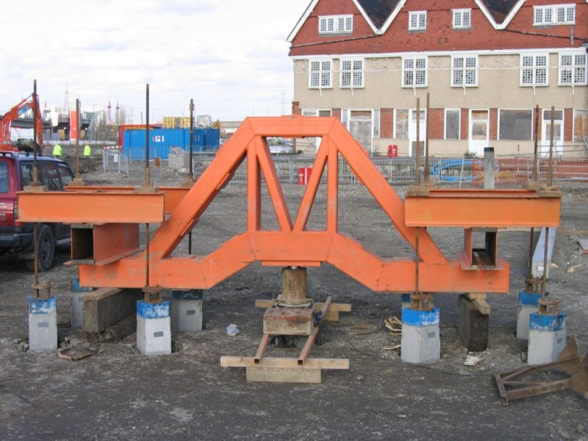
Pile Load Testing – Tension Piles
A Pile Test checks the pile design is adequate by loading up a pile by more than the amount of the building weight it is expected to carry, then measuring by how much it sinks, usually by about 10 mm or less.
The test works by installing two or more tension piles. These hold down a cross beam against which the pile is loaded by a hydraulic jack. The load on the jack can be hundreds or thousands of tonnes.
The tension piles are reinforced by dywidag bars which is a rebar made with a high grade steel and whose ribs form a helical onto which couplers or nuts can be threaded.
Although immensely strong, dywidag bars are brittle and once bent loose much of their strength. Never straighten a bent bar, or it will then snap under load.
dywidag bars are also damaged by heat, so never weld or burn near them, where a spark or could land on them.
Make sure dywidag bars are protected from site damage by barriers, signs and high visibility paint.
A load test that fails, will burst outward because of the loads under tension, just like elastic. Keep well clear.
Q. What three things can easily damage a dywidag bar?
Did you Know?
Dywidag bars are immensely strong but easily damaged. When they fail, they snap suddenly without any warning.
Tool Box Talk No: 01/13

Slide 17
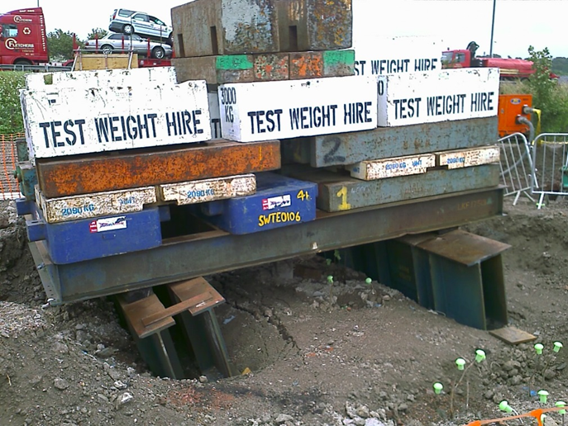
Pile Load Testing – Kentledge
A Pile Test checks the pile design is adequate by loading up a pile by more than the amount of the building weight it is expected to carry, then measuring by how much it sinks, usually by about 10 mm or less.
A Kentledge test works by building a grillage of weights on a frame over the pile, then jacking the pile down against the weights.
The weights can be concrete or iron blocks. In either case the total can amount to hundreds of tonnes.
Building up a kentledge test is a skilled job that is only to be carried out by a person trained for the purpose and working to a detailed drawing of the proposed assembly.
Building a kentledge may mean working at height. Ensure the risk of falling is eliminated.
When built, the kentledge assembly must be stable. Make sure the blocks are “bonded” like brickwork, with a block spanning the joint below.
Concrete blocks usually have recessed lifting eyes to stack easily. This recess can be a water trap that promotes corrosion of the lifting point. Check each lifting eye as you use it .
When complete, make sure the assembly is fenced off and warning signs erected
Q. Who is allowed to build a kentledge test?
Q. What must you check on each concrete block before you sling it?
Tool Box Talk No: 01/14

Slide 18
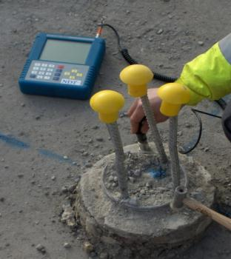
Pile Integrity Testing
What is Integrity Testing?
Pile Integrity Testing is a method of ensuring a pile cast into the ground is a uniform column of concrete.
It can be used to check if there are any horizontal cracks, inclusions or “necking” of the pile , which might mean it is too weak to support its load.
A sound wave is sent down the pile shaft to bounce off the bottom. By timing how long this takes the length of the pile can be measured. If the sound wave bounces off any cracks, inclusions or necked areas, it shows up, and the pile is usually condemned.
How can I ensure my piles pass?
Keep a positive pressure on the concrete at all times to avoid necking of CFA piles.
If there is an interruption in concrete supply, redrill the previously cast 500mm of pile to have a good joint between the setting and fresh concrete.
Don’t track the rig or excavator near recently cast piles, this can crack or damage them.
Remind the Main Contractor to take care when breaking down piles, especially if they are 450 or smaller.
Q. What is the purpose of integrity testing?
Q. What things can you do to ensure your piles pass?
Did you Know?
The integrity testing is usually done after you have left site. So if the pile fails, the rig has to come back at considerable expense to put in replacement piles.
Tool Box Talk No: 01/15

Slide 19
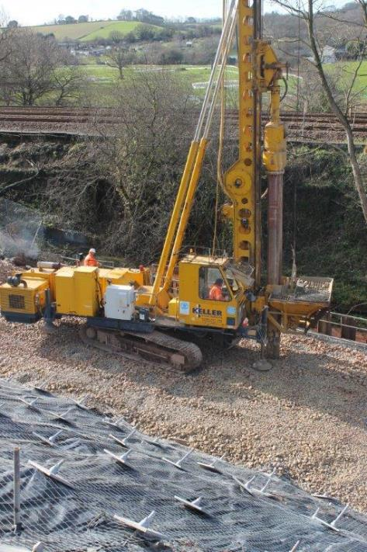
Vibroflotation
Rig operators must make sure that they have all round vision by mirrors/cctv. If not you must have a banksman.
Once you have tracked to probe position put ALL the legs down.
Do one thing at a time.
Never leave the stone skip suspended once the stone has been discharged.
Keep the carriage slides well greased.
Ensure that leaders and vibrator are plumb.
Do not tamper with electrics. Get a qualified electrician to attend to problems.
Shovel loaders should have rear view mirrors and flashing beacons.
The tyre pressures of the shovel loader are critical. Check them regularly.
Use shovel loaders only to carry loads in the bucket. They must not be used for any other lifting jobs.
Tool Box Talk No: 01/16

Slide 20
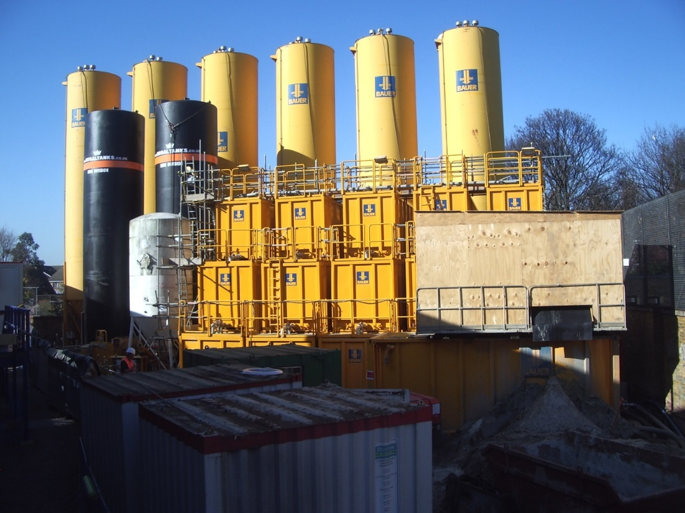
Bentonite
Bentonite powder is usually provided in bags but can also be delivered in bulk from a tanker. When mixed the fluid is slippery but relatively harmless unless ingested in large quantities.
When moving the bagged bentonite always follow good manual handling techniques. Only lift one bag at a time.
Mixing plant can be noisy and creates a splash hazard. Wear the appropriate PPE including ear and eye protection..
Bentonite slurry is usually used in connection with support to unlined excavations, either diaphragm walls or bored piles. Always ensure there is suitable edge protection for the process being constructed.
Keep the work area clean and tidy. Wash down any bentonite spillages to maintain a good working platform.
Ensure the excavation is adequately supervised and covered at all times.
Make sure electric cables and boxes are protected from getting wet/damaged
After using bentonite wash your hands, especially if eating or smoking.
Q. What PPE should you wear when mixing bentonite?
Tool Box Talk No: 01/17

Slide 21
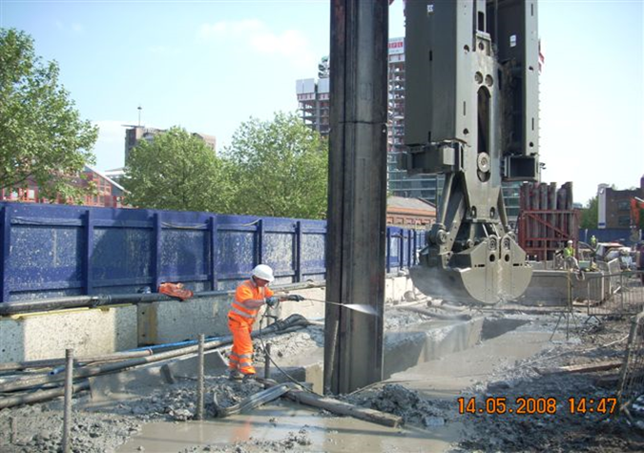
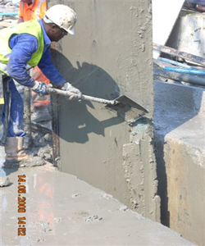
Cleaning Stop Ends
The extraction of stop ends can be regarded as a routine operation for many piling operatives but can be a risky operation if not done with care.
A Concrete, Clay or Bentonite crust can build up on the stop end during excavation of the Diaphragm Wall panel and stick to the stop end during extraction.
It is important that before the stop end is removed, appropriate tools and equipment is readily available for cleaning. Eg. Compressor and Breaker, shovels, hammer & chisel, pressure washers.
Large lumps of material should be cleared from the top of the stop end before the crane begins to remove the stop end from the panel.
Be prepared to stop if material is stubborn and takes more time to remove. All material from the front and reverse surfaces must be removed before the stop end clears the panel.
Ensure that the lay down area has already been prepared for the stop end and timber skids are in place.
Use poles and ropes on the stop end once it has been lifted from the panel. This will assist with positioning and turning the stop end when laying it down and prevent operatives standing beneath it.
Keep all non essential personnel clear of the operation at all times.
Did you Know?
A fatality occurred on a Diaphragm Walling site in Spain caused by a lump of concrete falling from a CWS stop-end following its extraction.
Q. Why must we ensure that stops ends are cleaned before and during extraction?
Q. What equipment will we need to clean the stop end?
Tool Box Talk No: 01/18

Slide 22
Bored Mini-Piling
Tool Box Talk No: 01/19

Slide 23
SFA Mini-Piling
Tool Box Talk No: 01/20

Slide 24
Displacement Piling

Slide 25
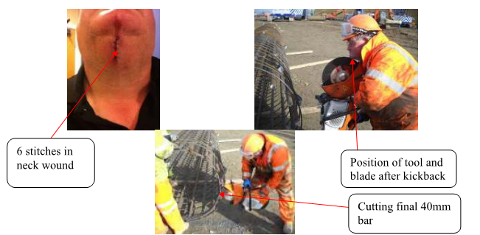
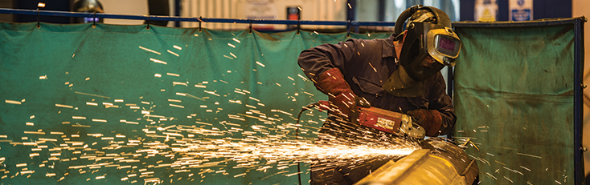
Abrasive Wheels
‘Abrasive Wheels’ is a term which includes all wheels and discs used for cutting or grinding on site.
Only persons trained and appointed can fit and use abrasive wheels.
Work with abrasive wheels can produce sparks and therefore may require a hot works permit. Ensure that the surrounding area is clear of combustible materials.
The machine and the wheel should have its maximum speed marked on it. This maximum speed should not exceeded.
Eye protection marked BSEN 166B (Goggles or visor) must be worn when using an abrasive wheel.
Different wheels are available for different jobs, make sure you have the correct one.
Never use the side of the wheel unless it is specifically designed for it Do not exert heavy pressure on the wheel to try and make it cut quicker, this may cause the wheel to shatter.
Keep fingers away from the moving wheel and make sure any guards are in place.
Stop the wheel when not in use. Disconnect from power supply where applicable.
When filling petrol machines use a filling spout and ensure that the filler cap is firmly replaced
Hold the machine such that if it kicks or jams it will not strike you
Q. Who can change an abrasive wheel?
Q. What should the machine and the wheel have marked on them?
Q. Why should you not exert heavy pressure on the wheel?
Tool Box Talk No: 02/01

Slide 26
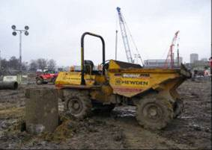
Dumpers & Site Plant
You should not drive a dumper unless you are over 18, trained and authorised to do so.
Carry out daily pre-inspection checks before you use all site plant, that it is in good working order. Report any defects to the Plant Manager.
Always drive the machine with due care, observing site speed limits. Use dedicated haul roads wherever possible.
Ensure loads are secure and evenly distributed.
If the dumper does not have cab protection ensure you are clear of the vehicle when it is being loaded. Engage the handbrake.
Always turn the vehicle off when leaving the drivers seat. When any site plant is left unattended the keys must be removed.
Do not take the any site plant on to a public road unless it is properly licensed. You must have a current licence to drive on a public road as well.
Do not travel across steep slopes. If you are travelling down a slope use a low gear.
Always park the dumper on level ground with the handbrake on
Make sure your vision is not impaired by the load.
Only use purpose made towing pins.
Only disconnect any towed plant on level ground.
Always ensure that the jockey wheel on and towed plant is secure before removing the towing pin.
Only adjusted the adjuster on the jockey wheel when attached to the dumper. Do not adjust when load is on the tow bar.
Ensure you do not place your feet under the tow bar when it is holding the weight of the plant.
Never stand up while the vehicle is in motion.
All dumpers now have Roll Over Protection Structures – Always wear a seatbelt
Do not carry passengers unless there is a separate seat designed for this purpose.
Q. How old must you be to drive a dumper?
Q. What must you do when a vehicle is being loaded?
Q. Where should you park your vehicle?
Tool Box Talk No: 02/02

Slide 27
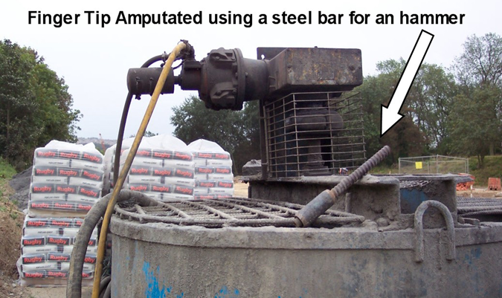
Use of Hand Tools
Always use the correct tool for the Job
Hand tools should be visually inspected for defects prior to use.
Simple Hand tools usually require minimal maintenance, but where necessary this should be carried as and when required.
Keep hammer heads tightly wedged on their shafts.
Replace all damaged handles and shafts.
Remove mushroomed heads from chisels and punches.
Keep the edges of all cutting tools sharp and in good condition.
Always keep your hands behind the cutting edge when working. Protect sharp edges when not in use. Remember to protect your eyes.
Use the right size spanner to fit the nut.
Store all tools properly in boxes or racks when not in use.
Always use screwdrivers correctly and not for work held in the hand.
All electric hand tools must be in good condition and maximum 110V.
Before using an electrical tool make sure that all cables, plugs and sockets are sound and properly wired up.
Disconnect power tools and store securely when not in use.
Where necessary, defective hand tools should be replaced if it is not economical to have an effective repair carried out.
Always wear the correct personal protective equipment for the job.
Hand tools should only be used for the job they were designed to do, e.g. screwdrivers should not be used as chisels.
Where specialist hand tools are to be used, training may be necessary prior to their use.
Q. What should be removed from
chisels and punches?
Q. What voltage are site electric hand tools?
Tool Box Talk No: 02/03

Slide 28
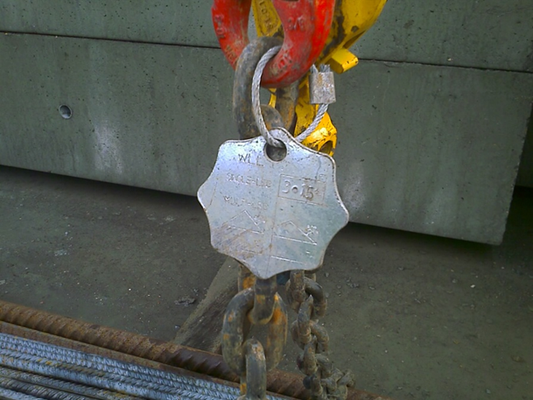
Lifting Equipment & Accessories
Lifting Equipment (cranes, forklifts, excavators etc) must only be operated by a competent, trained and authorised person.
Daily & weekly checks of machine condition should be carried out in line with the operators manual.
Lifting Equipment and accessories must be thoroughly examined by a competent person at the appropriate interval
Wire ropes and lifting hooks/eyes should be checked regularly.
Accessories such as slings, shackles, chains and strops should be checked prior to each use, and thoroughly examined six monthly by a competent person.
The lift plan should be followed at all times, if it requires changing the Appointed Person must be informed.
A competent slinger/signaller must supervise all lifts.
Always ensure personnel are kept clear during lifting operations.
Do not leave loads suspended in the absence of an operator and banksman.
Check Safe Working Loads (SWL) of all equipment and accessories prior to lift.
Never tie knots in slings, ropes or chains, if they are too long, get a shorter one.
Ensure lifting accessories are stored in a dry, clean place when not in use.
If any damage is noticed ensure the item is removed from service, a red do not use tag if attached, do not just put it back where you found it.
Always ‘test lift’ a load by lifting it a small distance before hoisting.
Keep loads as close to the ground as possible.
Do not allow persons to ‘ride’ on loads or in machines.
Use tag lines to stabilise/control loads. Ensure they are free from knots, loops and frays.
Wind speed and weather conditions must be taken into account before slinging the load and using a MEWP.
When lifting centre bars ensure the conductors are tightened and wired before raising to vertical.
Chains and nylon slings must be double wrapped when lifting any cylindrical material.
An up to date thorough examination certificate must be keep with the lifting equipment/accessories.
Q. Who can operate “Lifting Equipment”?
Q. How often should you check shackles, strops, chains and straps?
Q. When should you check the SWL of lifting equipment?
Tool Box Talk No: 02/04

Slide 29
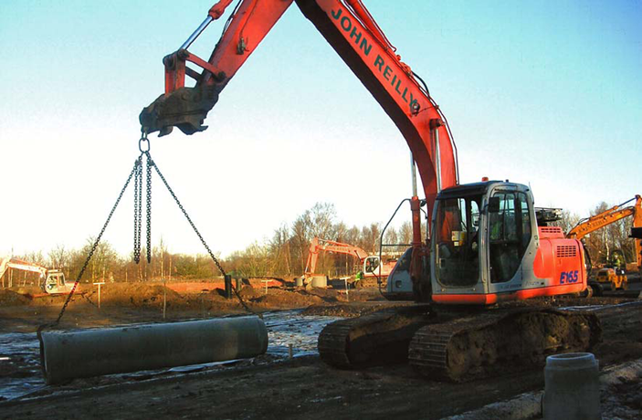
Excavators & Wheeled Loaders
Rotary piling (CFA, LDP & Mini Piling) normally produces spoil which is cleared by various machines. These machines have special risks and safety controls which must be followed.
You must only use equipment which you are trained, competent and authorised to use.
Excavators may only be used for lifting when there is an appropriate lifting point. Normally only lifts under 1Tonne should be carried out by an excavator.
The machine must be properly serviced and the daily and weekly checks should be carried out by the operator.
Ground conditions must be checked to ensure they are capable of taking the load of the excavator.
All services should be located, remember you may need a permit to dig.
All excavators should be fitted with 360° mirrors. If the driver cannot see he must stop and ask for a banksman.
Only use designated haul roads, do not track excavators ‘cross slope’.
Always switch of the engine and remove the keys when you leave the vehicle. Never leave a load suspended.
If anything is being carried in the bucket of the machine make sure it is secure.
A minimum of 600mm slewing space must be maintained. If this is not possible the area must be barriered off.
If excavators are to be used adjacent to open excavations stop blocks or other barriers must be in place.
Q. What must you use to lift with an excavator?
Q. What should all excavators have fitted?
Q. Where must you not track excavators?
Tool Box Talk No: 02/05

Slide 30
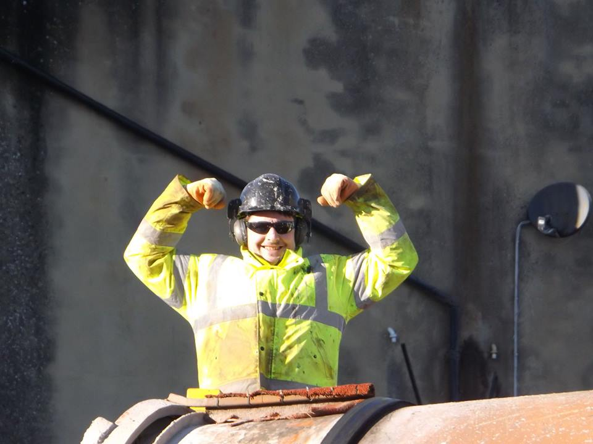
Banksmen & Site Plant
Banking of machines is a very important part of safely moving mobile equipment around a site. The word “machines” here means Cranes, Rigs, Dumpers, Forklifts, Concrete wagons, & any other site traffic.
The banksmen should be at least 18 years old, trained and competent to undertake banking duties.
Try to avoid travelling over uneven or broken ground and across slopes. Check the route before commencing movement. This should include slopes, overhead and underground services, gates, vaults ands any other fixed or temporary objects.
Try to avoid travelling with suspended loads , particularly those close to the capacity of the crane. When travelling with a suspended load ‘creep speed’ must be used and the load kept as low to the ground as possible.
Use only clear recognised signals. Stand where you can be clearly seen by the driver and where you can properly observe the operation. Wear appropriate hi-vis.
Never allow a gap of less than 600mm between the slewing part of a machine and other objects
No site traffic may reverse without a banksman.
When vehicles are being loaded the driver must be out of the cab unless he has cab protection.
Did you know?
The term banksman comes from the days of canal barges, when the “banksman” was the man leading the horse on the towpath.
Q. What must you check before moving a moving a machine?
Q. What type of clothing must a banksman wear?
Q. What is the minimum gap between slewing plant & other objects?
Tool Box Talk No: 02/06

Slide 31
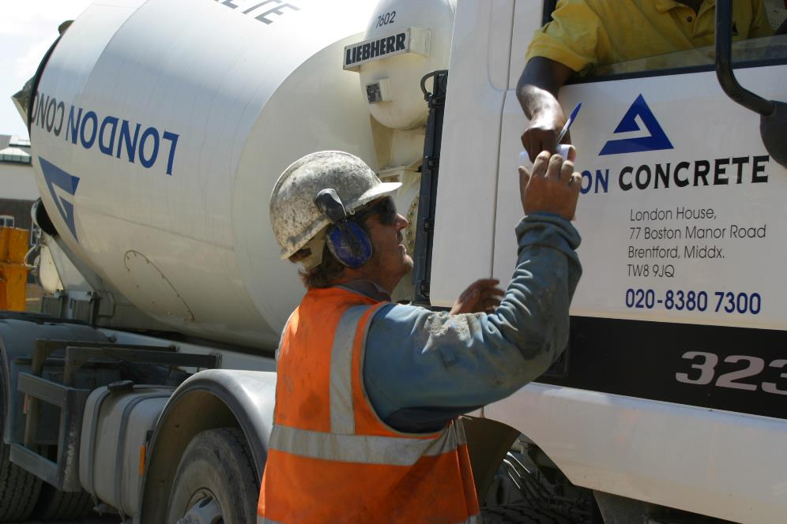
Ready Mix Concrete Trucks
When a ready mix concrete truck is full it is “top heavy” and the rear wheels are fully loaded. This should be considered when asking trucks to access certain locations.
When reversing, a concrete wagon on site must have a banksman in attendance.
Clear signals should be given to the driver by one person only
Wheels stops should be provided to prevent a vehicle getting too close to excavations or plant.
Trucks should take extra care when travelling on slopes, do not ask a truck to traverse a slope as it will become unstable.
Ensure setting out pins and other pieces of projecting rebar have protection caps placed over them as this will help prevent damage to the truck’s tyres.
Do not direct trucks through areas of the site which you know to be soft or slippery.
Remember to check the concrete ticket before you place the concrete. You should check that it is your concrete, that it has had the required tests and that the concrete is not too old (limit is normally 2 hours from batching)
Remind drivers that they should wear PPE when exiting the cab.
Take care when opening the discharge chute. Keep hands and fingers clear.
Eye protection may be required when pouring concrete to protect from splashes.
Concrete trucks should wash out in a location which will not contaminate the environment.
Q. What should a reversing wagon have?
Q. What should be provided at the edge of excavations?
Q. What should drivers wear when they exit their cabs?
Tool Box Talk No: 02/07

Slide 32
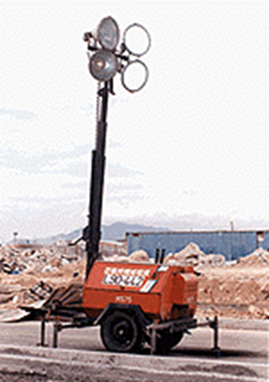
Tower Lights
Task lighting is important when ambient light levels are low. The most common method of providing task lighting is by using tower lights.
Always read the operators manual and safety instructions prior to using any lights as each manufacturers tower lights are slightly different
To erect
Extend outriggers and ensure trailer is level
Connect the earth to the ground rod & drive it into the ground – ensure the area is clear from underground services.
Engage the flat spring latch and release mast from support
Check winch rope and using winch raise mast to upright position
Engage latch in strike plate and tighten into position
Release the flat spring light and winch up lights – check for overhead cables and other obstructions prior to raising lights
To lower
Check trailer is level and outriggers are secure
Lower lights until latch clicks in
Tighten winch cable to secure
Release latch from strike plate & fold mast down
Secure to mast support
Remove earth rod, raise jacks and rear stand
Retract outriggers
When lights are in use remember to place a drip tray under the engine compartment, check and empty the drip tray regularly
When erecting lights consider those around you prior to placing them. Ensure lights shine towards where you need them and not outside the site or into public areas or other contractors work areas.
Q. What must you do before using tower lights?
Q. What must you check prior to using the winch?
Q. What must you have with the lights when they are in use?
Tool Box Talk No: 02/08

Slide 33
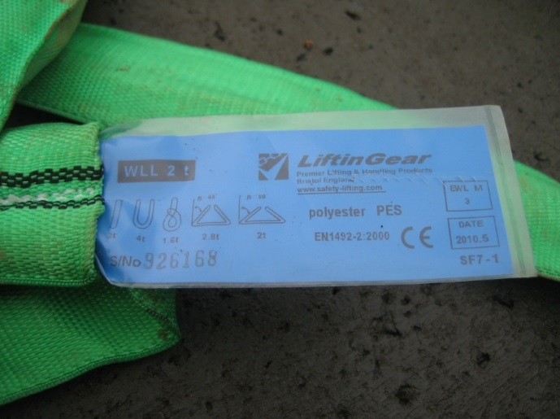
Use of Fabric Slings
Fabric slings come in two types; Flat Web Slings and Round Slings
A flat sling is made of woven polyester and can be Simplex, Duplex or Quadplex depending on the number of layers.
A Round Sling has an abrasion resistant outer cover with the load-bearing fibres inside
The lifting capacity of a sling is given by a colour code and the number of black stripes on the sling.
The number of stripes gives the SWL in tonnes, up to a maximum of 8 stripes.
Other colours are in use up to 8 tonnes. The three most common are:
Did You Know?
The lifting capacity of a sling depends on how it is slung; Choke 80%, U basket 200%, 90° basket 100%
Purple | 1 tonne/stripes
Green | 2 tonne/stripes
Yellow | 3 tonne/stripes
Always inspect before use and do not use a damaged sling for lifting
The sling must not be used on loads with sharp edges unless the edge is protected.
Do not knot slings or use a sling with a knot.
Do not re-use “one trip” after they have been removed from the load. Destroy them .
Q. What is the SWL of a green sling?
Q. What would 3 black lines on a sling mean? What colour would it be?
Q. What can you lift with a purple sling using a choke?
Tool Box Talk No: 02/09

Slide 34
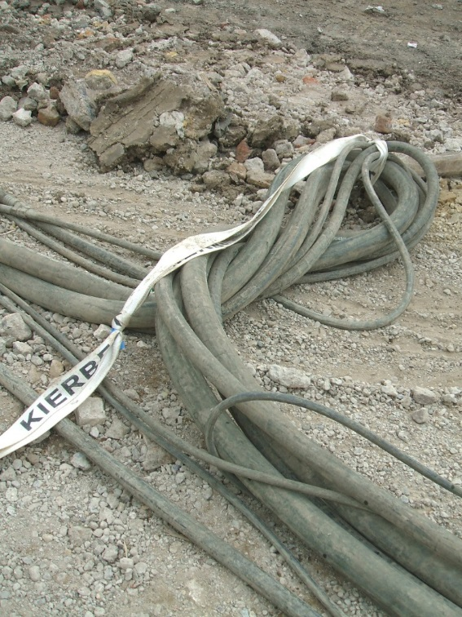
Single Trip Slings
The slings have been placed on the loads prior to shipment for your safety. Do not access the trailer to attach slings to the crane hook unless suitable edge protection is in place.
The slings supplied are flat woven webbing slings, made of man made fibre for general purpose use.
Single Trip Slings are easily identified as they are generally white or blue in colour and will state the scope of use on the safe working load tag.
The slings are thoroughly examined in the same way as other slings and lifting accessories and, to comply with LOLER ’98 will have certificates of thorough examination
Check that the sling is still correctly attached to the load prior to placing the sling on the crane hook.
Check that the sling has not be damaged during transit from the suppliers depot. Look cuts, tears and signs of heavy abrasion.
Check that the sling has not been trapped between loads prior to lifting.
Report any defects found to your supervisor.
Ensure that the sling is not trapped and damaged when placing the load on the ground.
If the slings remain attached to the load after lifting from the trailer, the slings must be checked again before the load can be lifted. The load can be lifted once more only, to its point of use.
Once the sling has been removed from the load the sling must be destroyed.
The sling should be cut so that it cannot be reused by others.
Ensure that the slings are placed in the correct skips on site and not left to accumulate.
Did you know?
Single trip slings were originally introduced to pre-sling loads and eliminate the need to climb onto the back of lorries or trailers.
The terms ‘Disposable’, ‘One use’ and ‘Single purpose’ have also been used to describe the use of the slings in the past.
Q. Typically, what colours will single trip slings be?
Q. What is the purpose of the load being pre-slung?
Q. What checks should be made to the slings prior to use?
Tool Box Talk No: 02/10

Slide 35
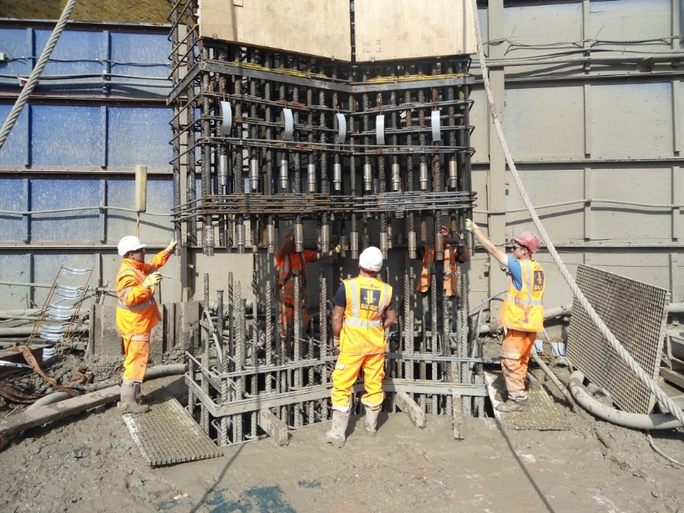
Handling Rebar Cages
Lift Plan.
The detailed method of handling reinforcement cages will be given in the Lift Plan in your site documentation. This will cover what lifting equipment you will be using , the weight of the loads and how they are to be slung. Have you been briefed on the Lift Plan?
Offloading and moving cages around site.
When offloading a cage, ensure the chains are long enough so the angle does not exceed 90 deg.
When lifting a cage horizontally, ensure the attachment points are strengthened to resist the tendency of the chains to pull towards the centre.
Use a tag line.
Generally do not stack cages higher that can be reached and slung safely.
Don’t stack cages more than two or three high where they may be unstable. Always chock against movement.
Inserting Cage into Bore.
The method of insertion , any splicing method and the means of suspending the cage will be covered in the Method Statement or Task Sheet. Make sure you have been briefed.
Lifting points should be examined to ensure they are secure.
When splicing a cage; do not thread your hands inside the cage nor stand on the casing; both risk amputation if the cage falls or is lowered accidently.
Ensure bulldogs are securely located and tightened using pneumatic gun, two bulldogs per bar per connection.
Do not climb up cage to connect bulldogs use podium steps provided if attaching at height.
Did you know?
The most common lift on a piling site is usually rebar – so make sure you do this right.
The hook on the ‘hanging chains’ will not have a safety catch, so it can only be used to suspend a cage when it is within the bore.
Q. What key documents do you need to be briefed on?
Q. Why is it important that horizontal lifting points are strengthened?
Tool Box Talk No: 02/11

Slide 36
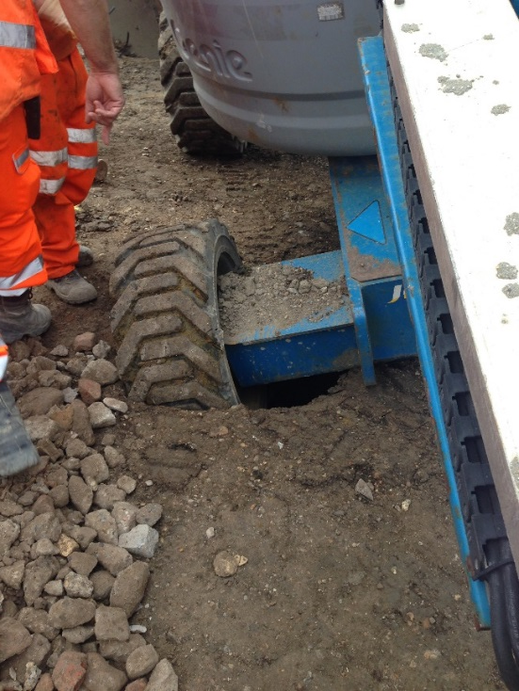
MEWPs
Cherry pickers provide a safe way of working at height. They allow the worker to reach the task quickly and easily, have guard rails and toe boards which prevent a person falling
Before using the cherry picker:
Carry out pre use checks to make sure it is in good working order.
Make sure the cherry picker can get to the work area safely
Is the ground level and firm enough to take the weight of the machine
Look out for obstructions, features or overhead hazards
Take steps to prevent passing traffic colliding with the platform
Prevent tools or materials falling from the platform.
Are you wearing a harness and short work restraint lanyard
Only get in and out of the platform when it is lowered fully
Make sure that the barrier or gate is closed and secured before raising the lift.
Have a colleague at ground level who can operate it in an emergency
Maintenance
Make sure the following are in good condition:
Wheels & brakes
Working platform, guard rails and the gate
Locking pins, joints & struts
All controls including emergency controls.
Descent alarm and horn is working.
Common causes of accidents:
Falling over the top rail
Worker misses a step or slips on accessing or getting down.
Machine overturns because it is not set up on a firm or level surface.
Machine overturns because of over-reaching or pulling/lifting a heavy object.
Mechanical failure
Machine is struck by another vehicle
Q. If you are manoeuvring the cherry picker on rough terrain or gradients, at what height should you have the platform?
Q. Why should you never climb or lean over the guard rails?
Q. Why should work restraint lanyards be short?
Tool Box Talk No: 02/12

Slide 37
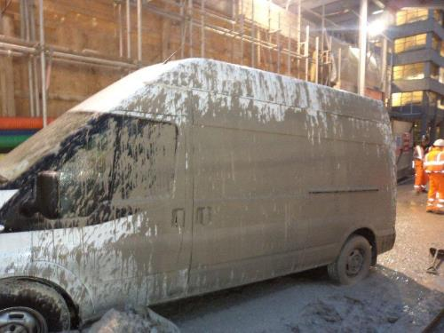
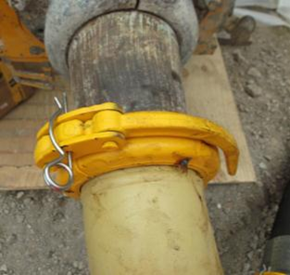
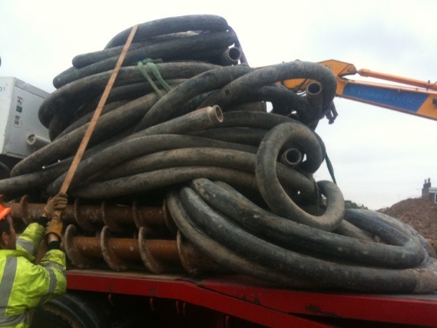
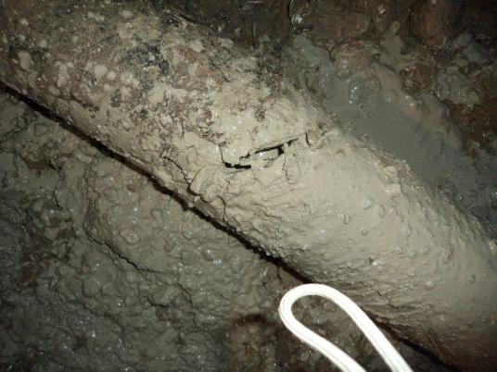
Concrete Hoses
Tool Box Talk No: 02/13

Slide 38
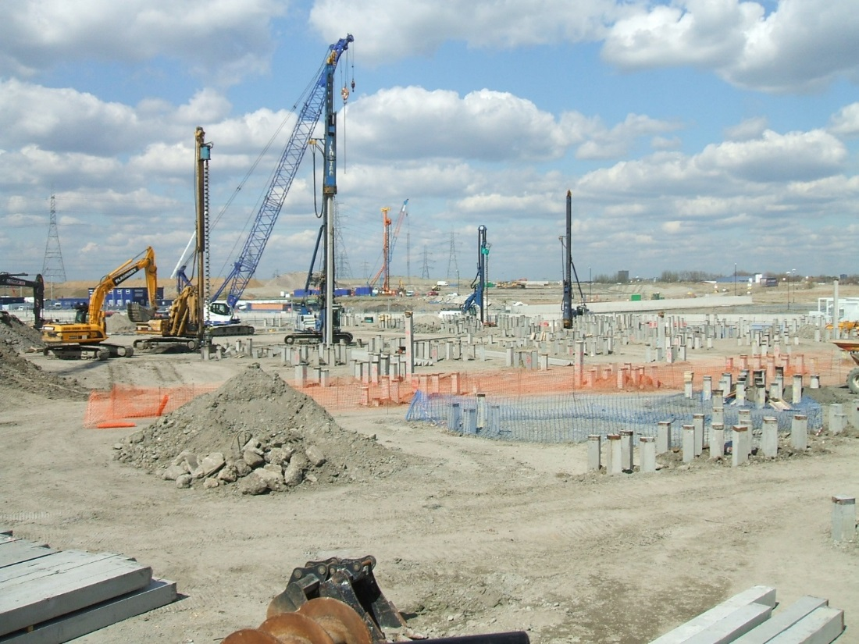
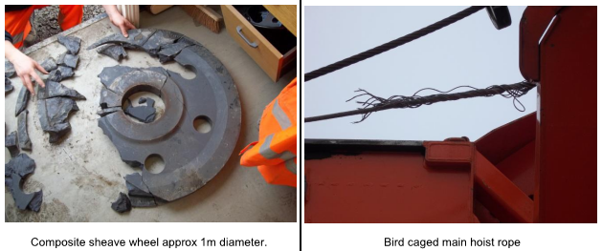
Piling Rigs
Drilling the pile or extracting the casing with the main hoist rope slack. This would allow the Kelly bar swivel to fall to one side and when the Kelly bar was rotated, this would cause the rope to unravel
Safe access – steps clear & in good repair
Exclusion zones
Positions of safety
Role of the banksman
Kelly ropes
Tool Box Talk No: 02/14

Slide 39
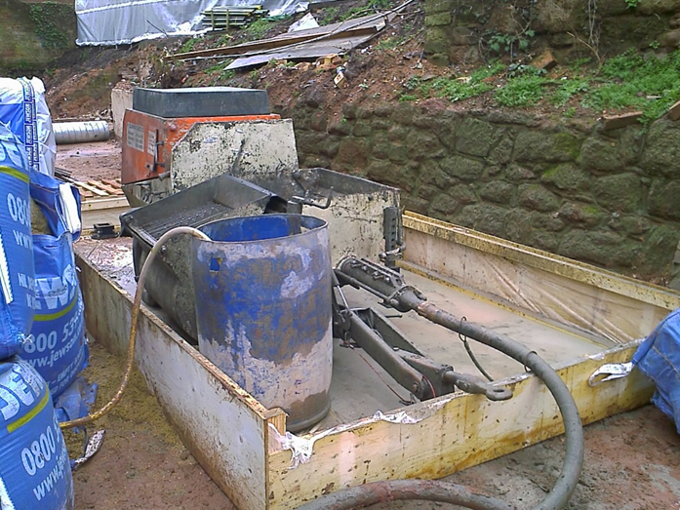
Grout Pumps
Tool Box Talk No: 02/15

Slide 40
Lorry Loaders
Tool Box Talk No: 02/16

Slide 41
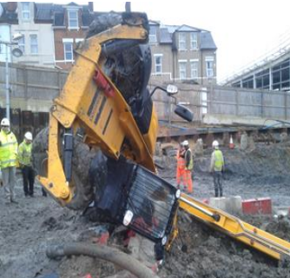
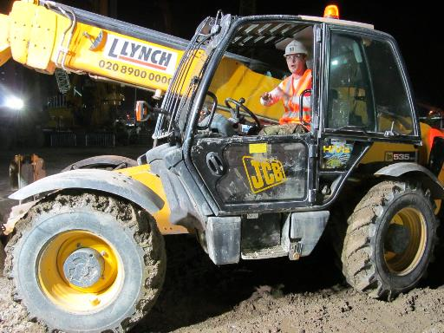
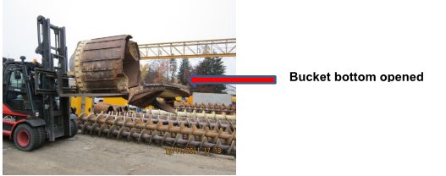
Telehandlers
OPERATING ON SLOPES – SIDE LOADING OF BOOMS SA135
ENSURE LOADS ARE SECURE
Tool Box Talk No: 02/17

Slide 42
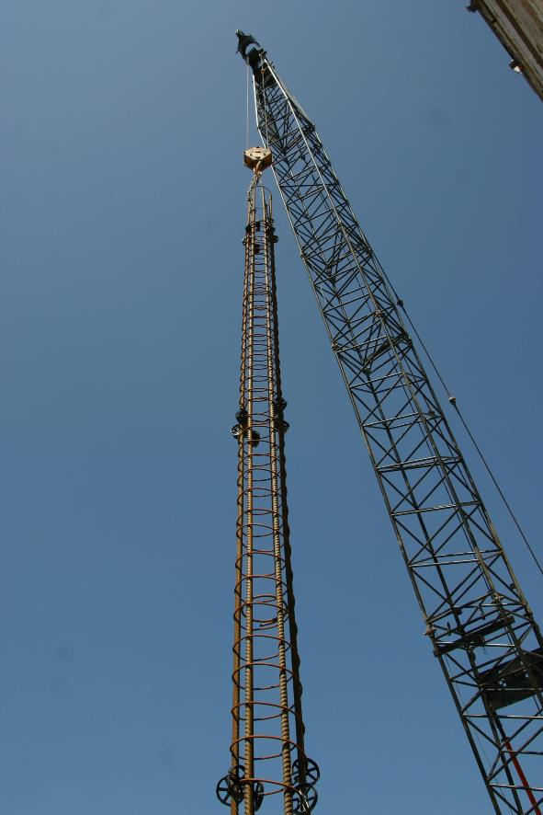
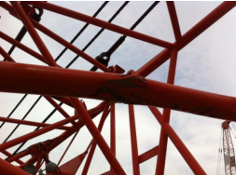
Cranes
Did you know?
Collisions between piling rigs and cranes are not uncommon – especially between loads/jibs and catheads because rigs and cranes have to work in close proximity. This is not only dangerous for you but can be very expensive as it damages hydraulics on catheads and struts on crane jibs have to be replaced. Always leave as much room as practical when using a crane to place loads near a rig, use tag lines to minimise the risks of loads swinging & if in doubt – STOP.
Tool Box Talk No: 02/18

Slide 43

Jetwashers
Pressure washers are used on a daily basis at work and at home. Many people underestimate the power of a pressure washer but they can lead to serious injuries when used improperly or if basic safety measures are ignored.
The sheer pressure of water alone is powerful enough to cause an injury. Dirt can be pushed through the skin’s surface which can lead to blood poisoning. Other people in the area are at risk of being hit by ejected material. Breathing in contaminated water mist can lead to ill health, not forgetting slips & trips from wet surfaces & trailing hoses
Operating procedures
Do not depress the trigger until you are sure of where the gun is pointing and use care not to spray your hands, feet or legs.
Use eye protection, waterproof clothing & gloves
Don’t use cleaners and degreasers that are not intended for use in pressure washers. Never use flammable liquids.
Think about your surroundings. Who else is in your area? Are they at risk? What about electrical circuits?
De-pressurise before attempting to remove lance or hose fittings. Never leave a pressurised unit unattended
Good housekeeping is required at all times. Keep hoses tidy & away from walkways.
DID YOU KNOW?
It only takes 100 psi to penetrate the surface of the skin. Water entering a finger-tip can push dirt as far as the palm of your hand.
An operative was using a
diesel powered jet washer (max 3000 psi) to
clean out a Bentonite tank. The water jet made
contact with his rubber rigger boot, making a small cut and causing a serious water injection injury that resulted in a six day hospital stay. Post-accident testing shows that even at 2000psi a water jet can penetrate thick rubber rigger boots in seconds. Leather boots offer less protection.
Q. What other risks are there from using pressure washers?
Q. Why should you never leave a pressurised unit unattended?
Q. Why should you pay particular attention to how close you are to electrical circuits?
Tool Box Talk No: 02/19

Slide 44

Manriders
Questions
Tool Box Talk No: 02/20

Slide 45

Housekeeping
Most injuries at work are caused from slips, trips and falls because of poor housekeeping.
It is often said that good housekeeping is one of the most important methods of maintaining workplace safety. Housekeeping is easy to overlook when trying to complete work tasks efficiently.
Keep your workplace tidy, especially access routes and working space around machines.
Ensure items are stacked/stored safely and in an appropriate container if required.
Store tools and other small items of equipment in the stores containers. This not only keeps the site tidy (eliminating tripping/striking hazards) but also means that small items will not get stolen.
Do not leave chains and strops lying on the ground. Stack them neatly in a clean dry area. This will eliminate trip hazards and prolong the life of the equipment.
Keeping your workplace organised will not only help safety but will increase productivity because you will have room to work. Do not store equipment and spoil on top of tomorrows pile positions, put them out of your way.
Ensure oils, greases and fuels are kept in appropriate bunds, store spill kits close by.
Rubbish and other waste products should be disposed of in the correct manner, greases and oils should be disposed of as ‘special waste’. Food must always be disposed of carefully to ensure that vermin are not encouraged
Q: Where should chains be stored?
Q: Why does good housekeeping make a site safer?
Q: How does housekeeping affect productivity?
Tool Box Talk No: 03/01

Slide 46

Working at Height
If you are working somewhere where you could fall and cause yourself injury then you are deemed to be working at height.
This could be standing on the back of a wagon to unload, putting pins in the mast of a machine, using a ladder to take shackles out of a casing or standing at the top of a batter.
If you are working at height then there must be something in place to stop you falling and hurting yourself.
Avoid the need to work at height if possible (work only from ground level).
Follow good practice (ask your supervisor if you are not sure)
Risk assessments should be carried out for work at heights (ask your supervisor if you have not seen these),
Plan and organise and ensure competent persons are involved.
Manage risks to avoid, prevent or reduce the chances of a fall.
Choose the correct work equipment and select best measures to prevent falls – work platform with guardrails before fall arrest.
Best Machinery – Hierarchy of access equipment.
Scaffolding
Mobile Alloy Tower
Mobile Elevated Work Platform
Ladders
Fall Arrest
If you think that there should be measures in place to prevent you from falling, or if the measures that are in place are not adequate then speak to your supervisor.
Did you know?
Around 50% of all fatalities reported year on year in the construction industry were caused by falls from height. Regulations were introduced last year to control ‘Work at Height’.
Q. What should be carried out before any Work at Heights?
Q. What should be considered before using fall arrest?
Q. What % of construction fatalities are caused by falls from height?
Tool Box Talk No: 03/02

Slide 47

Working Platforms
‘Working Platforms’ are the platform itself and all associated ramps and accesses, i.e. any surface which has to support construction plant.
Before any works commence a ‘Working Platform Certificate’ must be in place. Always check with an engineer before moving plant into a new area (or back into an old area) that the certificate is still valid.
The platform certificate will state the maximum bearing pressure that the platform has been designed to. If the type of plant being used changes, the certificate may not be valid (even if it is a smaller rig/crane) – always check with an engineer before taking any new plant onto a platform.
Platforms must be visually inspected on a regular basis, if weather is bad this could be daily or more. Visual inspections should be recorded on the foreman's daily diary.
If any part of the platform is dug up or if the platform requires repair it must be done in line with the design. Make sure it has been properly compacted.
Look after the platform in the area you are working. Clear spoil away, and minimise rig/crane movement by planning working sequences.
Check where the edges of the platform are – the platform will not always extend to the edge of the site.
All bores/excavations must be backfilled with self compacting material. i.e. granular not clay arising's
Did you know?
A piling rig fell across the main Tilbury to London railway line because when an obstruction was moved the platform was not properly reinstated.
Q: What is a working platform?
Q: What must you have before works commence?
Q: When might a certificate no longer be valid?
Tool Box Talk No: 03/03

Slide 48


Working Near Water
Precautions must be taken to prevent persons tripping, falling or being swept into the water.
Site tidiness is of special importance in minimising trip hazards.
Illumination is essential for night work.
Guardrails, ladders, safety nets, barriers and harnesses must be in good condition.
Systems must ensure that people who do fall into water are rescued in the shortest possible time.
Life-jackets or buoyancy aids should be worn when working near water.
Lifebuoys and rescue lines should be set at intervals along the workings.
A rescue boat should be provided when working over tidal water or fast flowing rivers.
Operatives should work in pairs so that there is always one to raise the alarm.
Some effective means of raising an alarm must exist.
Periodic checks should be made to ensure nobody is missing
Did you know?
Three quarters of all drowning incidents occur in inland water with well over half in canals, reservoirs, gravel pits and lakes. Most people who drown can swim.
Q: What type of underfoot conditions
would be a problem when
working near water?
Tool Box Talk No: 03/04

Slide 49

Work Near Roads
There must be adequate barriers to protect you from straying into the traffic - and the traffic from entering your work area
This barrier needs to be concrete blocks (Jersey Barriers) or Metal (“Varigard”). Cones are only acceptable for short-term, emergency or work adjacent to slow traffic, and then they must be roped and doubled
Keep crane jibs pointing away from the traffic or at worst parallel to the road. Use mechanical or hydraulic slew restrictors to enforce this
Mobile Plant including delivery wagons need to be properly signed and have twin amber flashing beacons
Long loads or cages need a double tag line to ensure full control. Remember you can’t push on a tag line!
At night, ensure floodlights do not dazzle drivers
NEVER Cross live traffic on foot. It is the responsibility of the Main Contractor to provide you with a safe access route.
When working at night or in poor visibility, your high-viz vest or coat needs to have double reflective stripes
Q. From what are you most at
risk?
Q. What restrictions apply to
crane jibs?
Q. What problems can floodlights
cause?
Did you know?
A car travelling at 70 mph has 4 times the energy of one travelling at 35mph.
Tool Box Talk No: 03/05

Slide 50

Work Near Railways
This addresses the situation where you are working adjacent to rail lines, but outside the fence. Where you are working inside the fence on Rail Property you need special training and need a “PTS” Card.
The boundary between your site and the railway must be securely fenced off. If you see any breaches of the fence or if it is damaged, inform your foreman
No rig or crane must be positioned where it could topple onto the railway.
Crane jibs must be kept parallel to or pointing away from the rail tracks so if the derricking ropes fail, the jib will not fall onto the tracks.
Long Casings or Cages must be secured back to plant so that they too cannot fall onto the track
If there is overhead power to the train, this will be at 11 thousand Volts. At this voltage, current can jump in damp conditions so never allow anything to pass over the rail boundary fence.
All crane loads must be guided with two tag lines to ensure it is under full control. Remember you can’t push on a tag line
Make sure the Foreman knows what the Network Rail Emergency Phone number is to be able to stop the Trains.
Did you know?
Crashes of high speed trains are very rare but when they do occur they can cause great loss of life.
Q. Why are you not allowed on Rail
Property?
Q. What is the Number 1 Rule for
Crane Jibs when working near the
Railway?
Tool Box Talk No: 03/06

Slide 51
Electrical Equipment on Site
All electrical appliances MUST be wired and tested by a trained and competent person
Test certificates must be retained in the site office for inspection by health and safety bodies
Appliances within the site cabins must have been “PAT” tested within a twelve month period
Heaters MUST never be covered with clothing. This usually occurs in the drying rooms
Consideration should be given when bringing new equipment in site cabins. DO NOT overload the sockets as this could cause a fire
Always turn off equipment when leaving a site at the end of a shift as they can over heat even in standby mode
As a rule all external voltage is 110v and double insulated on a construction site, but even 110v can be fatal so daily inspections is a good working practice
Double insulation means there is two sheaths on the cable. This can be identified by a tag the symbol is a square within a square
Trailing leads are a constant problem on sites and cause many slips and trips on sites, so consideration to others should be given if possible fix aloft or give warning signs
Did you know?
There are over 1,000 accidents every year involving electricity and around 30 of them are fatal.
Q. What is P.A.T. testing?
Q. Can a damaged cable be used
inside or outside?
Q. What is the maximum voltage for portable equipment?
Tool Box Talk No: 03/07

Slide 52

Overhead Services
Overhead Lines
Overhead lines is the cause of many accidents and serious injuries in the piling industry.
Assume all overhead lines are live until confirmed in writing even ALL POWER LINES CAN KILL.
Do not use rigs or cranes near overhead lines until you have been given full information as to the safe clearance zones by the local electric supplier.
Ensure that all rigs and cranes cannot encroach into the danger zone. This can be done by restriction devices on the rig or changing the type of machine to a smaller one that cannot reach into the danger area.
Where plant has to be operated near lines or move under power lines, goal post and warning signs MUST be present on site.
All work near or adjacent to power lines need to be properly supervised.
Did you know?
You don’t need to touch a high voltage cable to get injured, the current can jump through the air a considerable distance and especially in damp air.
Q. What must you assume about a cable you see?
Q. Why is it dangerous to work near live overhead cables?
Tool Box Talk No: 03/08

Slide 53


Underground Services
Different types of services present different risks but all must be treated with caution. Services include things such as overhead power cables, underground electric cables, telecommunications cables, gas mains, water mains and drainage systems.
Services are marked different colours so you know what they are.
Electricity – Black or Red
Water – Blue
Gas – Yellow
Telecommunications – Grey
Cable television - Green
ELECTRICITY
Treat all cables (overhead or underground) as live.
Maintain appropriate distances from known cables.
A trained competent person may be able to locate underground services using a cable location device.
All known cables must be clearly marked.
Any excavation near known cables or to locate cables must be done by hand.
GAS
Gas is flammable & explosive
If you smell gas, call the gas board.
Protect pipes when moving plant in the vicinity.
WATER
If water pipes are damaged call the water board.
Protect pipes when moving plant in the vicinity.
SEWERS
If a sewer pipe is damaged cordon off the area and phone the maintainer.
OTHER PIPES & DRAINAGE
All pipes and drainage should be blocked before piling to ensure that no contamination occurs.
Did you know?
You must have a permit to dig in place before starting work, however this not a guarantee that there are no services.
Q : ‘Name three types of services?’
Q : ‘How should you excavate close to underground services?’
Q : ‘What should you do when moving plant near underground services?’
Tool Box Talk No: 03/09

Slide 54


Restricted Working Space
Ensure there is always a proper safe access and egress , you may need it in a hurry.
Work to a plan so everyone knows what is happening and what comes next.
If in unoccupied premises, check all services are disconnected.
Check ventilation is sufficient, particularly when using machinery producing fumes.
Correct selection of plant equipment.
Ensure site traffic adheres to speed limits/Restrictions.
Adequate lighting must be provided, both for the working area and its surrounds.
Look up as well as around you frequently.
Keep site clean and tidy at all times paying particular attention to spoil removal.
After using tools replace them and all other equipment in their proper places e.g. Tool Container.
If working above ground remember there is no "safe height".
Keep people not involved with the work away, to maximise space.
TIDINESS IS ONE OF THE FOUNDATION STONES OF SAFETY
Q: What must be checked before
starting work?
Q: What must be remembered
when working above ground?
Did you know?
It is common experience in the piling industry to have to work in restricted areas. Even on larger sites the space available may be limited. Extra care is required in such circumstances.
Tool Box Talk No: 03/10

Slide 55


Property Protection/ Security/ 3rd Parties
We all have a legal and moral responsibility to ensure that the work we do does not injure anyone or damage anyone else's property.
There are many ways that our works can affect members of the public e.g. Children playing on construction sites, equipment or material dropping from height or spreading through on to public areas, Noise, Dust and vibration disturbing the local community.
We must insure that when the site is left at the end of a shift it is locked and secured.
Doors and windows must be closed and secured, gates must be closed and locked.
If you’re the last person to leave your bay or area insure all shutters are closed, lights are turned off and walkways are left tidy.
The last person to leave the premises will set the alarm and close the gate.
If suspect vehicles are parked or driving around record there number plate.
All visitors must come through reception and sign in and out of the premises. No unauthorised entry past the barrier into the yard area allowed. Inform management or challenged the person.
Visitors must be escorted at all times whist on site, PPE must be worn when you enter the yard area or the bays by all employees. [Hi-Viz zest], keep to the marked walkways and adhere to any signage displayed.
Site crews returning or working in the yard, must stay in the canteen area until given a task, they must wear PPE while walking around the yard and boots when working in the yard. [Hard hat and glasses will be required on some tasks.
It is important to report any near misses that you may see even in the office but especially if it is an event which could affect the public.
In order to make sure no one hurts themselves on site when they are not supposed to be there, we must be aware that people may trespass and make sure that we leave everything secure.
Contractors that are working on site, need inducting before they start work. We must ensure they are working safely and are using the correct PPE.
Make sure you tidy up after each shift or tasks has been completed.
All plant that is stored on either the hard-core at the front of the bays of or in the top yard must have drip trays placed if there is a chance of any leakages from hydraulics or diesel in the hard-core.
If you see anything your not sure about ask a question don’t just walk away.
Did you know?
Last 8 members of the public were killed following accidents on or near construction sites.
Q. How many members of the public were killed last year?
Q. Name 3 ways that members of the public could be injured by our works?
Q. Why must we keep our work secure?
Tool Box Talk No: 03/11

Slide 56


Storage & Stacking of Casings/ Cages
Casings and cage storage is not only important on site, but when being transported as well.
Cages and casings must only be slung and lifted under the direction of a competent person.
Slings and chains must be selected to ensure their SWL is not exceeded.
Long loads should be stabilised by use of tag lines.
When lifting trestles of cages always use a dedicated lifting beam.
Whenever possible cages or casings not contained in a trestle should be stored in a single row.
They should be stored on a firm, level base using suitable bearers.
Sufficient space should be left between each piece to allow access for slinging.
If this is not possible then cages/casings must be chocked and the following points should be considered.
The items placed at the bottom of the stack must be able to support the items placed at the top.
The bottom row must be chocked, or secured in some other fashion prior to items being placed on top.
Only stack above the valley of a fully supported bearer.
Each bearer must be secured by a wedge or chock.
When a cage/casing is removed from a stack make sure others in the stack are not disturbed.
Check the stack has remained stable after removal.
Stand clear of stacks when removing/placing items on them.
Q: Who can sling cages and casings?
Q: Why should you leave space between items?
Q: What should you do when you have removed an item from a stack?
Tool Box Talk No: 03/12

Slide 57


Slinging & Signalling
Slinging is a key function during piling operations and you must never become complacent about it.
All slingers must be at least 18, be trained, competent and authorised.
Any load being lifted should be slung and moved under the supervision of a slinger/signaller.
All lifting gear should be checked by the slinger prior to use. Lifting gear such as wire ropes which are impractical to check prior to every use should be checked at least once a week.
All lifting gear should have it’s Safe Working Load (SWL) marked on it. The slinger must check that it is suitable for the task prior to the lift.
Always use the correct equipment for the lift. ‘Making do’ can, and has killed people.
Loads should be slung and lifted in a manner that avoids causing damage to the lifting equipment.
Never tie knots in chains or shorten them using nuts and bolts. Get a set of chains that are the appropriate length for the task.
Make sure pins are properly screwed into shackles and that chains/slings are correctly fastened to the crane/lifting appliance.
Always lift the load so it hangs centrally. If it does not, lower it and resling it.
Make sure the driver can see you when you are giving signals. As a general rule if you can’t see the driver he can’t see you.
Always ‘test lift’ a load by lifting it a small distance before hoisting.
Use tag lines for long or large loads.
Keep loads as close to the ground as possible.
Do not allow persons to ‘ride’ on loads
When you have finished with lifting gear make sure it is put away tidily.
Q: How old must you be to be a slinger/ signaller?
Q: What should all lifting gear have marked on it?
Q: If you can’t see the driver, what can’t he see?
Tool Box Talk No: 03/13

Slide 58


Flammable Liquids & Gases
Gases are supplied in pressurised cylinders (bottles) and must be treated very carefully. If they are mistreated they may explode like a bomb (see tool box talk on compressed gases for more information on how to handle gas bottles).
Flammable liquids burn when mixed with the oxygen part of the air and an ignition source. A good way of preventing incidents involving flammable liquids is to keep them in closed containers. Always replace the lid when you have finished with a flammable liquid.
Containers of flammable liquids or gases must be clearly labelled and ‘fit for use’. Use metal containers for flammable liquids not plastic.
Store all flammable gases and liquids away from extremes of heat and cold and any sources of ignition. They must also be stored away from anything labelled ‘oxidising’ and anything that will burn easily.
When using gases all appliances connected to the system must be turned off separately to ensure there is no leakage from the system.
AVOID ALL SOURCES OF IGNITION. Some are obvious, like a lit match or a cigarette, however some sources are not so obvious. Things like electrical equipment, wall mounted heaters, sparks from cutting or grinding or equipment which has been recently used and is ‘hot to touch’ can all be a source of ignition.
Most flammable gases are heavier than air and will settle at the lowest level possible. Escaped gases will follow trenches and drains.
Flammable liquids will usually evaporate if left open to air. The vapours from flammable liquids can also be flammable so always use flammable liquids in a well ventilated area.
Did you know?
Fires will only burn if heat, fuel and oxygen are present. By ensuring there are no sources of ignition (heat) and that the amount of oxygen is kept to a minimum we can help to prevent the fires and explosions.
Q. When will flammable liquids burn?
Q. What should flammable liquids be stored in?
Q. Name four possible sources of ignition?
Tool Box Talk No: 03/14

Slide 59


Permit To Work Systems
Written permit-to-work systems are normally reserved for occasions when the potential risk is high, for example; hot works, excavations, confined spaces, electricity, under ground and over ground services.
When the permits to work are used in the work place their use should be covered during the induction training of all employees and contractors.
Permit to work systems normally use pre-printed forms, listing specific checks/ or actions required. For example; locations of underground services or emergency procedures.
Prior to works starting a permit-to-work must be signed by an experienced, trained and authorised person. For example a site manger.
No-one should be in a position to authorise a permit themselves to do works.
A permit will include details of the work to be done and what is involved, including all precautions required and emergency procedures.
A crucial point of principal is that no permit should be issued unless the persons issuing and receiving have personally satisfied themselves that the permit is properly made out, and have visited the scene of the work and verified that the specified precautions are in place.
Q: When should a permit be used?
Q: Who should sign the permit?
Tool Box Talk No: 03/15

Slide 60

PPE
Hazards should be avoided through engineering or administrative controls. If those controls are not available or unfeasible, personal protective equipment should be used to put a barrier between you and the hazard.
Personal Protective Equipment or PPE as we know it, is our last barrier of defence. There are many types of PPE but most fall into the following areas
Hard Hats – Designed to meet EN 397 and must be worn in hazardous areas. All sites are “hard hat areas” Make sure you have a hard hat, it is clean, in good condition and is not a borrowed. You do not know if it has been damaged
Goggles/Safety Glasses – Designed to meet BS EN 166 (various categories depending on use). You get 70% of information from your eyes Wear your safety glasses to protect your eyesight.
Ear Defenders –Designed to reduce to below 85dB, the level of sound you are subjected to. Your Company will have selected suitable defenders. Wear them to prevent short and long term hearing loss.
Jacket/Leggings – Designed to meet BS EN 471 class 3 or PR EN 343 Class 1. Can be supplied in Saturn Yellow or Hi-Vis Orange. To be worn to protect you from the weather and conditions and for others to be able to see you
Gloves – Many types of gloves are available. Use the correct type supplied to stop cement burns, contact dermatitis, cold, wet, vibration, sores and abrasions
Safety Footwear – Designed to meet BS EN 345 or BS EN 346. To be worn at all times in designated areas. The boots must have a protective toecap and protective soleplate.
Did You Know?
You have a ‘duty’ to
1. Use any PPE issued to you
2. Report any loss or defects.
3. Do not loan it to others.
4. Keep you PPE clean and in good repair.
5. Personnel Protective Equipment 2002 Regs
Q: “From where should you get your PPE?”
Q: “How often should you check your PPE?”
Q: “Where does your brain acquire most of
its information from?”
Tool box Talk No: 03/16

Slide 61

Fall Arrest Systems
If you use a damaged harness, or it is used incorrectly, you risk falling from height and being severely injured. People working below you are also at risk.
Inspect the harness carefully for:
Cuts at the edges
Surface abrasion across the face of the webbing
Damage to stitching
Any knot other than those intended by the manufacturer.
Chemical attack (flaking of the surface or a change to the colour of the fibres.
Contamination (e.g. with dirt, grit, sand, etc.) which may result in internal or external abrasion.
Defects and damage to D-rings, karabiners, grommets & buckles
Any bends or other kinds of distortions
Worn or sharp edges, Any sign of a crack or break
Looseness
Harness MUST have a current 6-monthly Thorough Examination with a copy of the test certificate on site.
Inspect items daily and record on Daily Plant Inspection Sheets
Taking care of the harness prolongs its life & makes it easier to see damage at an early stage.
Store in a dry, well ventilated place. Hang it up - do not store it on the floor or in a bucket
Make sure the harness is fitted correctly
Ensure that all clips / connectors are tightened / adjusted / attached.
Ensure that the webbing is adjusted to suit your body size
A loose harness around the legs and chest may FEEL more comfortable, but in the event of a fall the sudden “jerk” can cause serious damage. (especially the groin area, and internal organs!).
Did You Know?
A 1mm cut in a harness’ webbing can reduce its strength by 40%
Q. What damage would you look for when inspecting a harness?
Q. Why shouldn’t strong detergents or jet washes be used to clean harnesses?
Q. Why should you never wear a loose fitting harness?
Tool Box Talk No: 03/17

Slide 62
Pre- Start Checks
All hand tools, equipment, machinery, plant & vehicles should be subject to daily pre–start checks.
Never use anything without checking first it is safe to use.
Lorries have daily pre-start tick box list which must be done before it is driven.
When walking up to any machinery visual checks can be completed by looking around the machinery and looking for any signs of vandalism, damage & oil leaks.
Tool box Talk No: 03/18

Slide 63
COSHH
COSHH stands for Control Of Substances Hazardous to Health. It is a law which governs the way we use substances that might be harmful to us or other people.
Many things that we encounter everyday are hazardous to health. Substances that fall under these regulations include fuel, oils, greases, cement, welding fumes, wood dust, and even some bacteria. They can enter the body through inhalation, ingestion, injection or absorption through the skin.
Any substance that you use on site that might harm your health must have a COSHH assessment carried out on it before you use it.
A COSHH assessment will tell you how the substance could harm you and what you need to do in order to make sure it doesn’t.
Your supervisor should tell you before you use any new substance what the hazard is and how you can avoid it. Ways to protect yourself might include things such as only using the product outside, keeping the lid on the container, wearing gloves, wearing glasses and not smoking when using the product.
Always read the label on any substance before you use it. The label will also tell you how to use a substance.
Always wash your hands before eating or drinking even if you have been wearing gloves
If any substance is taken from its original container and put in a new one the new container must be labelled. This is so people know what they are using.
Did you know?
Every year approximately 12,000 people are diagnosed with illnesses caused by exposure to hazardous substances.
Q: ‘What is COSHH?’
Q: ‘What will a COSHH assessment tell you?’
Q: ‘Name three ways a COSHH assessment might tell you to protect yourself?’
Tool Box Talk No: 04/01

Slide 64



Protecting Hands & Feet
The majority of accidents that happen in the piling industry involve hands and feet (see ‘Did You Know?’)
Hands and feet are frequently injured because we use them for so many things. Because we use them all the time we forget about them and do not look after them.
The most common injuries to hands are cuts and crushes. The best way to stop these injuries is to keep your hands out of the way. If you can’t keep your hands out of the way make sure you are wearing gloves and look at where you are putting your hands, is there anything sharp, or anything that might move and trap you?
The most common injuries to feet are caused by dropping things on them, or by tripping over things. Good housekeeping will mean that you are less likely to fall over things and using the correct manual handling techniques will mean you are less likely to drop things on your feet. Safety boots with steel toecaps and midsoles, are only to be worn.
Remember wearing gloves and boots will also help to protect your skin from harmful chemicals like concrete, oil, grease and fuels. These chemicals can cause your skin to react giving you uncomfortable rashes or even dermatitis. Dermatitis is a permanent condition which in severe cases can be disabling.
Did you know?
Over half of the serious injuries reported to the FPS involve hands and feet.
Q. What is the most common type of injury in piling?
Q. Why do hands and feet get injured more?
Q. How can good housekeeping help prevent injuring yourself?
Tool Box Talk No: 04/02

Slide 65


Personal Hygiene
Dermatitis is caused by the skin coming into contact with certain substances. It is NOT infectious.
Some things might affect you almost the first day you use them, some might take weeks, months or years to surface.
Read the labels on any substance before use.
Dermatitis could affect your health, livelihood, family and social life.
Use barrier cream on hands & arms.
Wear the appropriate PPE, especially gloves.
Always wash your hands before eating, before and after using the toilet.
If you must smoke, then avoid doing so with dirty hands.
Clean eating areas immediately after each break.
Dispose of waste food properly or you will attract vermin.
Rats can transmit Weil’s disease.
Please leave welfare facilities as you would wish to find them.
Do not wear oil contaminated clothing next to your skin.
If you have cuts or sores, then keep them covered.
Q: What would happen to your social life if your exposed skin was affected?
Did you know?
Dermatitis starts with redness, itching, scaling or blistering. If it gets worse the skin can crack and bleed and spread.
Tool Box Talk No: 04/03

Slide 66

Manual Handling
Manual handling injuries are very common and very easily avoided. A manual handling injury is not just straining your back, but might include dropping things on your feet or crushing and cutting your fingers with the load.
Whenever possible use mechanical means to lift or carry equipment.
If you do need to lift something, assess the load first, if you don’t think you can lift it, ask for help.
Remember to bend your knees and use the power in your legs to lift the load. Your legs are much stronger and less prone to injury than your back.
Hold the load close to your body, this reduces the strain on your back and shoulder muscles.
Where are you taking the load? Can you get there safely and can you put the load down? Check before you pick the load up! Make sure you have a good grip on the load, try to avoid holding things by just ‘fingertips’. If the load has sharp or jagged edges make sure you are wearing gloves to prevent your hands getting cut.
Try to avoid twisting your body when you are carrying a load, not only does this put a lot of strain on your back but it can also affect your balance which may in turn cause other injuries like twisted ankles.
If more than one person is lifting make sure everyone is ready before you lift
Did you know?
All piling companies have minor injuries caused by lifting, carrying, pushing or pulling equipment, materials and tools.
Q : What is a manual handling injury?
Q : How should you lift things?
Q : ‘What can twisting your body do?
Tool Box Talk No: 04/04

Slide 67

Skin Diseases
Many materials used on site are potentially harmful to our skin. These are often covered by a COSHH assessment which will tell you how to use a substance safely. Before you use any new substance or material check if there is a COSHH assessment and what it says. Also read the packaging on the material as this will often tell you how to use the product safely as well.
One common skin disease is contact dermatitis. This can be caused by cement, greases, oils, fuels and other chemicals.
You may get an allergic reaction to substances, this may be a rash, swelling and/or itching.
You may become sensitised to a product, this means that only tiny amounts will cause you to react again.
Symptoms of dermatitis include itching, swelling, a rash, dryness and cracking of the skin, blisters, weeping sores and infections. If you think you have any of these symptoms tell your manager and get yourself checked by a doctor.
Dermatitis cannot be cured, but it can be controlled.
You can help to protect yourself from dermatitis by following instructions on product usage, wearing appropriate PPE and good hygiene.
Some situations make you more susceptible to dermatitis. These are friction, extremes of temperature, extremes of humidity and exposure to chemicals.
There are other skin diseases which can be caused by chemicals. These include things such as skin cancer and acne.
The image below shows contact dermatitis of the ankle.
Q: What are some of the symptoms of dermatitis?
Q: How can you protect your skin?
Q: What other skin diseases could you get?
Tool Box Talk No: 04/05

Slide 68

Working in Confined Spaces
A ” Confined Space” can be defined as any space which is substantially enclosed e.g. storage tanks, pits, trenches, ducts, some areas or rooms within buildings, particularly below ground level, sewers, tunnels, box girders etc.
The main risks associated with Confined Space Working are:
Toxic gasses e.g. hydrogen sulphide, ammonia carbon monoxide.
Explosive or flammable gasses, e.g. methane, petroleum spirit.
Oxygen deficiency or enrichment. Air contains 21% oxygen. Any less than this, we can pass out and an excess can cause fire or explosion.
You must not enter a confined space unless you have received special training.
You must not enter a confined space unless a Permit to Enter has been issued and you have received a full briefing on the Permit Conditions and the Risk Assessment.
A rescue procedure must be in place and a practice rescue carried out.
Q: What do we mean by a “Confined Space”?
Q: Name three risks of working in Confined Spaces?
Q: What is the normal level of oxygen?
Tool Box Talk No: 04/06

Slide 69
Respirators – Working in Confined Spaces
Hazards associated with Confined Spaces fall into two categories:
Hazards associated with conditions which exist in confined space before work takes place, e.g. lack of oxygen, toxic chemicals, explosive gases, etc.
Hazards which can be introduced into the confined space by work to be carried out, e.g. fumes from welding operation, unsuitable electrical equipment etc.
The effect, with certain gases can be very rapid or take place over long periods e.g. Hydrogen Sulphide (smells of bad eggs) and can be formed from decaying organic matter. Hydrogen Sulphide causes Chemical Asphyxia resulting in unconsciousness / death in minutes.
Carbon Monoxide (Exhaust fumes from Internal combustion Engines) can cause Headaches, at low concentration over a period of hours, or death in a period of minutes if the concentration is high.
Q. What action should be taken before entering a confined space?
Tool Box Talk No: 04/06

Slide 70

Respirators – Working in confined spaces
Low level - Long Term Carbon Monoxide poisoning will cause permanent health damage such as Heart Disease and Brain Damage.
All Equipment that produce Carbon Monoxide e.g. Power Packs, Compressors, Generators Etc. must be located outside the works area to enable the gases to vent to the atmosphere.
Portable Abrasive Wheels (Petrol Driven) also produce Carbon Monoxide and should not be used in a Confined Space. Be Aware, when locating the Plant Equipment outside, that the fumes do not blow into the confined space. Remember also the wind direction can change.
IF ANY PERSON SUSPECTS THAT THEY ARE BEING AFFECTED BY HARMFUL GASES, THEN THEY MUST LEAVE THE WORK AREA IMMEDIATELY AND REPORT TO THEIR SUPERVISOR.
Q. Where should you locate your plant equipment that is engine driven?
Q. What action would you take if you thought you were being affected by harmful gases?
Tool Box Talk No: 04/06

Slide 71
Respirators – Working in confined spaces
Monitoring and Control.
The Site Supervisor will ensure that: The planned procedures, including any permit – for – work systems, are carried out as planned and that only trained and authorised persons are permitted to enter the confined space after monitoring for gases.
Ensure all controls measures identified in the Risk Assessment's for the work has been implemented.
Where necessary, the Health & Safety Department on request, can arrange any necessary training, air monitoring, and prepare relevant Safe Systems of Work, Permits for Work Systems etc. and will provide advice on any relevant equipment.
Q. Will a respirator (filter mask) provide protection against harmful gases such as carbon monoxide?
Tool Box Talk No: 04/06

Slide 72

HAVS
Hand Arm Vibration Syndrome is commonly called HAVS.
It is caused by prolonged exposure to high levels of vibration, this is often as a result of using hand held tools.
Exposure to high levels of vibration can cause impaired blood flow to the fingers, nerve damage, swelling and pain in joints, and long term muscle damage may also occur.
Symptoms can include; tingling and numbness of the fingers, ‘blanching’ of the fingers (they go white in cold and/or wet weather), loss of feeling of touch, loss of strength in your hands/fingers.
When you are using hand held tools an assessment must have been done before you start work. This assessment should include how much time you can safely use the equipment for.
Other ways to prevent HAVS are to ensure tools are well maintained and that your hands are kept warm and dry.
If you think you have any of the symptoms of HAVS it is very important to get checked by your doctor. HAVS can be a disabling disease.
Did you know?
It is estimated that nearly 300,000 people in the UK suffer from HAVS.
Q: What are some of the symptoms of HAVS?
Q: What should be included in the assessment of the work?
Q: What can you do to help prevent HAVS?
Tool Box Talk No: 04/07

Slide 73

Drugs & Alcohol
Alcohol and drugs are proven to affect your ability to respond normally to situations at work.
Drugs which can affect your ability to work do not just have to be illegal drugs. Prescription drugs or even medicines which are purchased from a shop can also affect the way you work.
If you are taking any medicines which you think may affect you at work inform your supervisor. Most medicines which will affect you have information written on the box which will tell you of any possible ‘side effects’ such as drowsiness.
The amount of alcohol which you are allowed can vary from site to site. Normally the limit is 80mg per 1, but on ‘rail’ sites this is reduced to 30mg per 1.
Taking drugs or drinking excessive alcohol does not just affect your performance at work. It can affect your personal relationships and cause severe long term health problems which can result in premature death.
A guide to how much you can safely drink is up to 4 pints of ‘normal’ strength lager. You must leave at least 8 hrs before starting work for this amount of alcohol to have left your system when you start work. If you drink more (or stronger) drinks it will take longer for the alcohol to leave your body. This amount will vary from person to person and should only be used as a rough guide.
Although the penalties for being caught with cannabis have been reduced in the UK it is still an illegal drug. Cannabis stays in your blood stream for around 30 days after you have taken it.
You can be asked to provide a random drugs and alcohol test at any time during your employment. Refusing to take a test is just as serious as failing one.
Did you know?
If you feel you may need help with either a drug or alcohol dependency, contact the HSQE department or your labour supervisor who can give you the details of organisations that can proved advice. Any request will be treated in complete confidence.
Q. What drugs can affect you at work?
Q. Is cannabis legal?
Q. When can you be asked to take a drugs and alcohol test?
Tool Box Talk No: 04/08

Slide 74

Hot Weather
Although we associate outdoor work with healthy living, too much sunlight is harmful. A tan is a sign that your skin has been damaged by the ultraviolet (UV) rays in sunlight.
Certain workers are at high risk (raise hands):
Do you have fair or freckled skin?
Does your skin go red or burn before it tans?
Have you fair or ginger hair or light eyes?
Have you moles on your skin?
What are the Dangers?
Burning , blistering and sunstroke.
Premature aging and leathery appearance.
But the real danger is the increased risk of Skin Cancer, which is a killer.
How can you avoid the risks?
Keep arms, legs and torso covered.
At break times, go into the shade.
Use high factor sunscreen, minimum SPF15.
Check your skin regularly. If spots or moles change shape or colour or start to itch or bleed, see your doctor promptly
You also need to drink plenty of water to avoid dehydration, especially if you are doing manual work.
Did you know?
The most common cancer in the UK is Skin Cancer, there are over a 100 new cases diagnosed each day.
Q. Why is prolonged exposure to sunlight hazardous?
Q. How can you avoid the risks?
Tool Box Talk No: 04/09

Slide 75


Cold Weather
Tool Box Talk No: 04/10

Slide 76

Workplace Noise
Working in a noisy environment can damage your hearing in the longer term. You may not notice the effect until you are older, but by that time it will be too late. There is no cure.
Another effect of excessive noise is “Tinnitus” This is a buzzing or ringing in the ears that won’t go away. It is very unpleasant.
“Noise” is transmitted by air-vibration. To protect your ears you must control the amount of vibration that gets to your ear-drum.
If you see the blue warning sign, you must wear hearing protection. This is because the noise level of the plant has been measured and found to be above the “action level”. Supervisors must enforce this.
The noise produced by typical work equipment will often increase significantly if it is not well maintained, so keep your kit in good order.
The amount of hearing damage caused by noise is strongly related to the length of exposure. So it makes sense to take your breaks in a quiet environment, away from noisy plant.
This graph shows the hearing test of a patient with noise induced hearing loss. The loss of hearing in the voice is about 400Hz.
Did you know?
Hearing damage caused by excessive noise cannot be cured because the tiny hairs in the inner that pick up sound get permanently flattened like trees.
Q. What is the cure for hearing loss caused by excessive noise?
Q. What is ‘Tinnitus’?
Q. What two things influence the amount of hearing loss?
Tool Box Talk No: 04/11

Slide 77

Protecting Our Environment
Protecting the environment is something which should be part of our everyday activities. Most of the steps we take to protect the environment are common sense and have other benefits as well.
The main ways to protect our environment are:
REDUCE NOISE – shut off engines when they are not in use, keeps doors and covers closed
ELIMINATE SPILLS – use drip trays, take care when transferring liquids, get leaking machinery fixed.
REDUCE WASTE – use small containers, reuse what you can, store items correctly so they do not ‘spoil’
RECYCLE – if you cannot reuse something can someone else?
DISPOSE OF ITEMS CORRECTLY – separating waste means that harmful items can be disposed of properly. Make sure each type of waste goes into the correct skip.
ELIMINATE SMOKE – burning things releases harmful gases into the environment. Do not burn rubbish on site.
CONTROL DUST – dust is not only irritating but it can affect the wider environment as well, damp down dust at source.
SAVE ENERGY – switch off machines, lights and generators when they are not in use. Turn off taps when you have finished and turn down radiators rather than opening windows.
Did you know?
Carbon Dioxide (CO2) is a greenhouse gas, which is bad for the environment as it causes global warming.
Burning fuels releases CO2.
Last year the piling industry released nearly 40,000 tonnes of CO2 into the atmosphere.
Q. How can you reduce noise?
Q. Why must you not pour oils into drains?
Q. What releases CO2 into the environment?
Tool Box Talk No: 05/01

Slide 78



Contaminated Land
Contaminated land is land that has been polluted with harmful substances.
Unlike the pollution of surface watercourses, ground contamination has a potentially long-term impact.
Contamination causes risk to health and the environment.
Small amounts of heavy organic compounds like pesticides, dyes, solvents or paints, oils, and metals can pollute land.
Small spills, over a long period of time can accumulate to become a major problem.
Health problems can be traced to contaminated sites and can also lead to prosecution.
Ground contamination originates from poor storage, handling and disposal of chemicals and fuel.
All these problems can be avoided by using good environmental controls and practices:
  Maintain good housekeeping.
  Dispose of all waste types into correct containers.
  Report any spills immediately and take action using clean up facilities where necessary.
  Storage areas and tanks must have adequate bunding around them. The bund capacity MUST be not less than 110%.
  Containers and barrels containing substances such as petroleum, oil or chemicals MUST be returned to the correct storage area at the end of any working day.
  Any open containers must be covered to avoid potential spills and vandalism.
  Dispose of empty containers and drums into the correct waste facilities as they always retain some liquid and could cause ground contamination.
Did you know?
Local authorities are inspecting sites across England an Wales to identify where the land is contaminated. It is expected that as many as 100,000 sites are contaminated, this almost 1% of the land area of Great Britain.
Q. What causes land contamination?
Q. What action should you take if you cause an oil spillage?
Q. Why do we cover open containers?
Tool Box Talk No: 05/02

Slide 79
Environmental Noise & Vibration
Noise and vibration not only affects those people employed on site, but also affects those living and working near the site.
There are strict limits imposed on the amounts of noise and disturbance that a construction site can cause its neighbours. Some sites have extra restrictions imposed on them by local councils.
All of us have a responsibility to our neighbours to keep this disturbance not just to the levels specified, but as low as we can.
Ways we can do this include:
Not working outside of site hours. If we do need to work outside site hours it is important to get the appropriate permissions.
Switching off plant and equipment when it is not in use, especially at the end of a shift.
Closing all doors and covers on plant to keep noise levels down.
Positioning plant and equipment where it will cause least disturbance to our neighbours.
Reporting defective equipment and properly maintaining equipment and plant.
Wherever possible we should be using plant and equipment especially designed to reduce noise (‘silenced plant’) and using techniques which will not cause excessive vibration.
If a complaint is made, be diplomatic and ensure the complaint is passed to the appropriate people promptly
Did you know?
Even normal construction noise can be a nuisance at certain times of the day or night. This can lead to enforcement action by the local authority, including closure of the site.
Q. Who does noise and vibration affect?
Q. When should you switch off plant and equipment.
Q. If a member of the public complains to you about the work, what should you do?
Tool Box Talk No: 05/03

Slide 80

Water & Ground Pollution
Main risks from spillage of oils and diesel
Ensure that all fuels / oils are stored correctly
  Fuel bowsers 110% bunded
  Barrels stored on drip trays or in “safe” areas
  All containers correctly labelled
  Spill kits and persons trained in their use to be available
  Bowsers locked when not in use.
When bowsers are re-filled, delivery is to be supervised by competent site personnel.
Take extra care when refilling plant with fuels.
If spills occur
  STOP the source if possible.
  MOP up any liquid with spill kit.
  CLEAN up any contaminated ground
  Correctly dispose of contaminated materials.
  If it goes into water course inform your supervisor immediately.
Other sources of water contamination
Pile spoil
Concrete and concrete wash out fluids
Prevent material from entering drains or water courses. Use correct storage and forethought.
Don’t hide it, report it !
Did you know?
When spilt on water 1 gallon of diesel spreads out to over the entire area of two football pitches.
Q. Where should you store diesel ?
Q. What Should YOU do when there’s a spill ?
Q. Who do you inform ?
Tool Box Talk No: 05/04

Slide 81
Emissions & Air Quality
In the 1950’s, the air in London was so polluted that in the winter, for days at a time visibility was down to a few metres by “smog”, a mixture of fog and smoke from coal fires. Thousands of vulnerable people were killed each winter.
A series of “Clean Air Acts” have produced a healthier atmosphere by banning coal fires to cut down pollution.
it is now illegal to produce excessive exhaust fumes under the Environment Protection Act.
Excessive smoke from a diesel is a sure sign of an engine with problems. Get it repaired before it breaks down.
Keep emissions down by switching off plant that is not working. This cuts down noise and saves fuel.
Keep fumes and vapours from operations such as burning and welding to a minimum.
Never light a fire on a construction site.
Did you know?
Ozone depletion is a major threat to the planet, we must all do our bit to help protect the atmosphere.
Q. What two things can I do on site to cut down air pollution?
Tool Box Talk No: 05/05

Slide 82

Waste Minimisation & Sustainability
The volume of waste produced in the UK in just 2 hours would fill the Albert Hall. In the UK we are running out of room to safely store all our waste. Therefore we need to look carefully at what we throw away and how we dispose of it.
All waste must be properly segregated into one of the three categories, inert, hazardous or non-hazardous
Waste transfer notes must now identify waste by using a special six-digit code as well as a written description of the waste
Many Landfill sites are now not allowed to take HAZARDOUS waste. This has substantially increased the cost of disposing of this type of material. It is very important therefore to take special care not to cause spills etc. It is also very important to make sure that waste is properly segregated. One empty oil drum in a skip of canteen waste would mean the whole skip would need to be disposed of as hazardous waste.
Where ever possible waste should be MINIMISED, REUSED or RECYCLED.
By recycling waste we don’t use so many of the earths natural resources. Most natural resources are not infinite, they will run out, so it is important to conserve them
Did you know?
Running electrical equipment overnight in an average office wastes the same amount of energy as it takes to run a small car for 100 miles.
Q. What are the three categories of waste?
Q. What must be written on a waste transfer note?
Q. Why can you not mix hazardous and non-hazardous materials?
Tool Box Talk No: 05/06

Slide 83

Asbestos
What is asbestos?
There are different types of asbestos. The most common are white, brown and blue asbestos, but be careful as they all appear white and therefore they must all be treated as dangerous.
Asbestos has been used extensively throughout the world for insulation boards in buildings, asbestos cement roof sheeting and cladding, drainage pipes and guttering, sprayed coating, pipe lagging and even some flooring tiles. In the past it has been dumped widely and so you may encounter it on site
How do I get harmed by Asbestos?
Asbestos can only injure a person through inhalation. If there is asbestos in the ground, on equipment or clothing this can be disturbed and you could breath the fibres in. Because asbestos fibres are rod shaped they get stuck in the lungs causing disease.
What illness is caused by asbestos and how long does it take to show up?
Mesothelioma is a cancer of the lining of the lungs. It is considered to be exclusively related to asbestos exposure. By the time it is diagnosed, it is almost always fatal. Mesothelioma has a long incubation period of at least 15 and sometimes as long as 60 years.
Asbestosis is a scarring of the lung tissue.. This leads to inadequate oxygen intake to the blood.. It is a slowly progressive disease with a latency period of 15 to 30 years.
Lung Cancer is a malignant tumour of the Lungs. The tumour grows through surrounding tissue, invading and often obstructing air passages. Again, the disease has a long incubation period – typically at least 20 years.
How can you avoid these diseases?
If you suspect the presence of asbestos, stop work immediately and inform your supervisor. Never touch or disturb Asbestos.
Did you know?
Asbestos is a slient killer.
Since 1968 50,000 workers have died of asbestos exposure, with a further 3,000 dying every year up too 2010.
After 2010 the death rate will start to fall.
Q. What typical asbestos products could you find on a construction site?
Q. If you identify any type of asbestos in your work areas what should be your course of action?
Typical asbestos products
Tool Box Talk No: 05/07

Slide 84

Fuel Storage
Fuel can refer to many different things. In this tool box talk we use the term fuel to refer to liquid fuels such as petrol and gas oil.
The most commonly found fuels and oils on site are diesel and petrol [for engines], oils [gearboxes, hydraulic systems].
Poor storage, lack of care during refuelling, vandalism and poorly maintained plant can all result in a spillage.
A spillage could become expensive if not cleaned up, pollution can cause the likelihood of prosecution and a large fine.
There are three main hazards associated with fuel. These are:
Environmental pollution caused by spills
Fire
Skin disease
By making sure we follow a few simple rules we can avoid harming ourselves or others when handling and storing fuels.
Fuel should always be stored in metal containers. If more than 200 litres are to be stored then the storage area must be double bunded however it is good practice to store fuels in bunds regardless of the amount of fuel stored. Bunds must be monitored to make sure that they don’t fill up with water or fuel.
The area immediately surrounding the fuel storage area should be designated as ‘no naked flames’. This includes smoking.
Clean out drip trays regularly to stop overflowing of possible contaminates.
Report all spillages to your Supervisor. Always return containers to a bunded area after use.
It is also important to keep the area around a fuel storage area clean, tidy and free from combustible materials.
When fuel is being discharged a spill kit mat should be used wherever possible. This will mean any small spills are caught by the mat.
Whenever fuel is being handled you should wear gloves. If any fuel is splashed on your skin then make sure you wash it off immediately.
If a spill does occur then the appropriate spill kit should be placed to absorb the spill.
Any contaminated spill kit material needs placing in the blue bag provided and placing in the appropriate waste container ready for disposal.
Q. What are the three main hazards of fuel?’
Q. What type of containers should fuel be stored in?
Q. What should you wear when handling fuel?
Tool Box Talk No: 05/08

Slide 85

Spill Control
Spill Kits should be maintained in and around all locations where Hazardous Materials/Hazardous Waste are stored, handled or disposed of.
Protect yourself by using your PPE including: gloves, goggles and suits where applicable; and extinguish all cigarettes-SAFETY FIRST!
Do the Spill Drill -- REACT!
REMOVE THE SOURCE – Stop the drip, plug the leak, tighten the joint, replace the part etc.
ENVELOP THE SPILL – Put down a pad or boom to prevent the spill from travelling further
ABSORB – Put down a pad or granules on the spill to absorb it.
CONTAIN THE WASTE – Place used absorbent material into a plastic bag & move it to the correct area or put it straight into the hazardous waste disposal.
TRANSMIT A REPORT – Tell your supervisor what you have spilt and where and what you have done about it. Make sure the spill is logged in the action plan appropriate notification is sent to the HSQE dept.
By Reacting quickly, you eliminate hazards that could cause injury. You also give the spill less of a chance to seep into the ground, which makes clean-up easier and can help to protect water resources.
For major spills talk through the process of working with the drilling site management and the use of the Environment Agency HOTLINE NUMBER (000-807060)
Make sure you know where the spill kits in your workplace are located and how to use them.
Q. What is the spill drill?
Q. What does A in the spill drill stand for?
Q. Where should used spill kits be put?
Tool Box Talk No: 05/09

Slide 86



INCIDENT CONTROL AT TIME OF SPILLAGE
Where this is not possible, protect surface water drains and soakaways by using sandbags, mats or other devices. If possible collect/absorb the spillage. (Figs. 2, 3)
Once a spillage incident has been identified assess the hazard and decide ‘IS IT SAFE TO PROCEED?’
If the answer is YES - continue with Spillage Control Procedure as per flow chart.
If the answer is NO - go to emergency action plan as described in flow chart.
Put on suitable Personal Protection Equipment (PPE) if not already done so and inform all necessary staff.
At the earliest possible point, considering all safety aspects stop the source of the spillage or leak.
Confine the spillage using spill kit materials, keeping liquids away from drains, gullies, foul sewers, surface water and ground water. (Fig 1)

Slide 87

Waste Management
Waste Management and control is a vital element in the construction industry.
Every year millions of pounds are wasted by poor management of material and resources.
Waste must only be removed from site by a licensed carrier.
All waste leaving the site must be accompanied with a correctly completed consignment note.
Consignment notes [or Waste Transfer Notes] are legal documents and must be retained for the specified periods of time. [3 Years]
The golden rules are:
Prevent – Avoid producing waste in the first place.
Reduce – Minimise the amount of waste you produce.
Reuse – Use items as many as possible.
Recycle – Recycle what you can only after you have reused it.
Dispose – Dispose of the waste to landfill.
Waste comes from many different sources. i.e. contaminated ground, road sweeper arising's, excavations, material off cuts, leftovers, damage, concrete. Anything not used is classed as waste.
Minimising waste by following the golden rules takes more effort but is good for the environment and the company.
Segregating waste into hazardous, non hazardous and inert types for disposal or recycling maximises opportunities for recovery costs and penalties can be avoided.
Waste must be stored in a suitable and secure container to insure there is no cross contamination.
Control Measures
Store materials properly and safely to prevent damage before use.
Keep significant off-cuts for reuse and know the correct place to stockpile and protect materials for reuse.
Consider the quantity of material to be used before ordering or opening a pack and use it all before opening a new pack.
Reuse materials [Such as formwork and shuttering] where practical.
Tell your Supervisor/ Manager about instances in your work where you could reduce waste.
Failure to manage waste correctly, from storage to final disposal, will result in prosecution, this will then cause negative publicity, leading to loss of reputation, leading to loss of business.
Tool Box Talk No: 05/10
Tool Box Talk No: 05/10

Slide 88

Hand Tools - Yard
We use many hand tools as part of our jobs. These may be powered tools like grinders or they may be non-powered tools like hammers and spanners.
Although these tools are smaller and look less dangerous than big machines and heavy tools they can still cause serious injuries.
Hand tools should be checked each time they are used. If they are powered tools always check the cable to make sure it is not damaged. Make sure heads of hammers are securely attached.
Hand tools must be stored in the appropriate area. This will not only ensure they remain in good condition by keeping them clean and dry but will also ensure they don’t get lost.
If you need to carry small tools then make sure you have a belt or a box to carry them in. Never climb a ladder with tools in your hands. If you are working at height with small tools then make sure they are stored securely somewhere that they cannot fall & injure someone.
Always make sure that you have the appropriate tool for the job. Using the wrong size/weight of tool is a common cause of accidents.
Q. What are hand tools?
Q. Where should hand tools be stored?
Q. What should you check before you use a hammer?
Tool Box Talk No: 06/01

Slide 89

Loading & Unloading Rigs & Cranes
Loading and unloading plant is an activity which we carry out regularly but it can be a hazardous activity if we do not follow a few simple rules.
Some items of plant require special trailers etc in order to transport them safely. It is important to make sure that the correct trailer is used for the plant.
The person driving the rig on and off the low loader must be trained and competent to move that item of plant.
The rig driver should be in charge of loading/unloading the machine, although the haulier must have some input and the haulier is responsible for securing the load.
A trained and competent banksman must supervise the loading/unloading of the machine.
The plant will often need a ramp in order to safely access the trailer. Some trailers have these built in, in other cases a ramp will need to be created from timbers and sleepers. If a ramp is to be built it should be not too steep for the plant to climb.
Plant should not be ‘spragged’ on the ramp. If the plant needs realigning then it should be tracked off the ramp realigned and tracked back on.
Whenever possible plant should be loaded/unloaded in an area away from the public and from other vehicles to ensure that there is room to manoeuvre the machine safely. If this is not possible then extra personnel should be made available to control vehicle and pedestrian movement.
If plant is to be tracked on tarmac made roads then suitable protection should be provided.
When getting into or out of the cab whilst it is on the low loader the driver should always use the short ladder provided
Q : ‘Who should have a CPCS card?’
Q : ‘How long should a wooden ramp be?’
Q : ‘When can you ‘sprag’ plant on a ramp?’
Tool Box Talk No: 06/02

Slide 90

Paint Shop
Housekeeping is particularly important in the paint shop area, space may be limited and the persons working will be concentrating on the task in hand not looking for items which have been left for them to trip over.
Paint must always be stored in a closed container to prevent fumes from escaping. Always try to finish one container before opening another.
Paints, varnishes, solvents and stains can contain hazardous chemicals or solvents including heavy metals. Unwanted paint, with the lid firmly attached to prevent leakage, should be taken to the hazardous waste disposal area, where it will be disposed of in the correct manner
Always ensure there is appropriate ventilation available
PPE must be worn at all times, this must include glasses and appropriate respiratory protection to prevent droplets of paint from entering your eyes and lungs
Paints, varnishes, solvents and stains are nearly all flammable liquids, therefore they need to be stored carefully in closed containers away from naked flames.
Smoking is not permitted in the paint shop or the paint shop stores.
Q: ‘Why is housekeeping important?’
Q: ‘Where should unwanted paint be put?’
Q: ‘What PPE should be worn?’
Tool Box Talk No: 06/03

Slide 91

Plant Maintenance
Every piece of plant and equipment that we use at work requires maintaining to make sure it works efficiently and safely.
Some maintenance jobs need doing every day and some only once or twice a year.
Any items noted as faulty during the maintenance checks must be notified to the plant yard (or the owner of the equipment) as soon as possible. This will allow an assessment to be made of how urgent the work is & schedule it in.
The exact maintenance requirements will be detailed within the operators manual however as a general guide:
Daily
Check oil levels.
Check fuel levels and filters.
Check air filters.
Check and grease where required.
Check all securing nuts.
Weekly
Check all ropes, strops and other lifting accessories attached to the equipment.
Check tyre pressures or track condition.
Check all lights (both internal & external).
Check all mirrors and other visual aids.
If you are unsure what the maintenance requirements for any piece of plant are then ask.
Q. When should maintenance be carried out?
Q. Where are the maintenance requirements detailed?
Q. How often should you check securing nuts?
Tool Box Talk No: 06/04

Slide 92

Steam Cleaning
Steam cleaning and jet washing is a task which many of us do not perceive as hazardous however there are certain things which we should take into consideration.
Housekeeping is very important around the area where cleaning or jet washing is to take place, the area may become wet and slippery underfoot so it will be even more likely that people will fall over things left in the way.
The jet wash/ steam cleaner should be visually checked prior to each use, any damaged hoses should be reported and repaired before the machine is used.
The jet wash/ steam cleaner should be serviced in line with the manufacturer’s recommendations and a weekly maintenance sheet should be completed weekly.
PPE must be worn when using the jet wash/ steam cleaner. This should include waterproof clothing and waterproof footwear with good grips on the soles.
A full face visor should also be worn when using the jet wash/ steam cleaner.
Remember to visually check any electric cables in the vicinity before commencing work, water combined with electricity can kill. This includes the machine being cleaned, make sure it is switched off before you clean it.
Q. Why is housekeeping so important?
Q. What PPE should be worn?
Q. Which electrical cables should you check before starting work?
Tool Box Talk No: 06/05

Slide 93

Gantry Cranes
The key risks when using the gantry crane include: The crane can collapse through overloading or if it is poorly maintained. It can be damaged through mis-use, and if its use is not controlled, the load can strike a person, or damage surrounding structure/equipment
Make sure that you carry out pre-use checks, including obvious signs of damage. Check that the controls work properly and that limit switches stop the crane’s movement. Check that the crane travels smoothly. Never use damaged equipment
All lifting accessories must be stored in a dry place, preferably hanging on a rack where they will not get tangled up, wet or contaminated by dirt, grease, concrete etc.
Leaving the Crane -The control must always be turned OFF when not in use (using the emergency stop button).
Always leave the Crane in a safe condition. Remove any slings from the hook and raise the hook to the upper position.
Safe operating procedures
Protect lifting accessories from damage & make sure they will remain secure throughout the lift
Never overload the equipment
Before lifting, ensure that the hoist is directly above the load and that it is slung evenly and correctly.
Ensure that the load is free before attempting to lift.
Ensure the path of the load and crane is clear of personnel, objects, and obstructions.
Do not hoist or crane into the travel stops at full speed.
Do not travel with a load dragging along the floor.
Do not lower the hook so far as to allow the ropes to go slack. If this happens the operator should determine that the rope is properly wound on the drum before moving a load
Never stand below the load or allow any other personnel to do so
Hoist into the load at slow speeds, avoid snatching or sudden hoist movement.
Q. What should you check before you use the crane?
Q. How and why should lifting accessories be stored?
Q. Why should loads always be lifted vertically?
Tool Box Talk No: 06/06

Slide 94

Cutting & Welding
Cutting and welding must only be done by people who are trained, competent and authorised.
Welding, burning and cutting can generate noxious fumes. If ventilation systems are available make sure that they are functioning and that you use them.
Do’s & Don’ts.
Do:
Examine all equipment for damage or leaks
Make sure flash back arrestors are fitted on gas bottles.
Make sure you have the correct nozzles if you are using gas
Have a fire extinguisher next to the work area
Wear appropriate PPE
Keep gas cylinders upright
Don’t:
Work in poorly ventilated areas
Work near items that could easily catch fire
Leave the area without checking there is no risk of a fire developing.
Q. When should you use a ventilation system?
Q. Where should a fire extinguisher be located?
Q. How long must you wait to check an area after finishing work?
Tool Box Talk No: 06/07

Slide 95

Loading & Unloading Equipment
Every year people are killed whilst unloading or loading wagons and other vehicles.
Always follow the Five Rules for safe loading/unloading:
Only load/unload wagons on firm, level ground
Check the load before driver removes/places straps, are all items chocked, is anything likely to fall?
If items require extra chocks, do this before the driver removes the straps.
Keep the area around the vehicle clear of obstructions (People & Vehicles) during loading/unloading.
If the load has moved during transport and you are unsure as to the safest way to unload it, ask for advice from your supervisor. Think about where you will place the load. Is it safe & accessible?
Never access the back of a wagon unless appropriate measures to prevent falls are in place.
Remember that the person unloading the wagon may not have the equipment you do, always consider how a load will be unloaded when you are loading it
Only climb onto/off a wagon using designated access/egress routes (wheels and tow bars are not designated routes)
Never stand on the back of a wagon whilst the load is being moved if there is a risk the load could knock you off or move suddenly and trap you.
Only climb onto a wagon if you are sure it safe to do so (Have you checked the load is secure?). Think about whether you have to climb up at all!
Q. What should be safe and accessible?
Q. What must you do before the driver removes the strops?
Q. How should you climb onto a wagon?
Tool Box Talk No: 06/08

Slide 96
Machine Guarding
Q
Tool Box Talk No: 06/09

Slide 97
Dust
Q
Tool Box Talk No: 06/10

Slide 98

Fire Safety
There are lots of things in an office that can cause fires (electrical equipment) & offices are also full of things that burn really easily (paper). Imagine if there was a fire in your office, all of your paper records lost, your computers damaged beyond use, maybe your electronic records unrecoverable. Do you think your company could survive if all of this was lost?
There are some simple things we can all do to help minimise the risk of fires starting:
Make sure your electrical equipment is safe – has it been PAT tested, are the leads damaged, does it work properly, if there is a fan can air get to it easily or is your paper piled on top of it?
Don’t leave clothes hanging over radiators overnight
Turn equipment off when it isn’t being used, especially over the weekends/over night.
Look at what you have stored in your office – minimise piles of paper and other flammable things (like PPE), make sure they are not stored against electrical equipment.
Make sure you know where your closest fire exit is. Do you know how to operate all the fire doors?
If you notice a fire exit is blocked then try to clear it! If you can’t clear it yourself, or even if you have tidied everything away then tell your office fire warden so they can keep an eye on it.
Make sure any visitors are escorted if an alarm goes off.
If you smoke make sure you extinguish your cigarette completely.
If there are any chemicals stored in your office it is important to think about how & where they are stored. Aerosol cans can explode if they get hot – do you have any cans of furniture polish or air freshener in your office? Where are they stored? What other flammable things (paper towels, cleaning clothes, other cleaning chemicals) are stored with them
Another common cause of office fires is arson. What can you do to help minimise the risk of arson at your office? Who would you tell if you saw someone acting suspiciously? Who would you contacted if you noticed the gates/doors had been left open at the end of the day?
It has been estimated that each fire in a commercial building costs approximately £75,000. This includes property damage & down time to the business. On average businesses have to close for 6 weeks to recover/rebuild after a fire.
Tool Box Talk No: 07/01

Slide 99

Accident & Near Miss Reporting
Tool Box Talk No: 07/02

Slide 100
Use of Computers (DSE)
Tool Box Talk No: 07/03

Slide 101
Manual Handling (Office)
Tool Box Talk No: 07/04

Slide 102
Slips, Trips & Falls
Tool Box Talk No: 07/05

Slide 103
Driving
Tool Box Talk No: 07/06

Slide 104

Housekeeping (Office)
Most injuries at work are caused from slips, trips and falls because of poor housekeeping.
People not clearing up after their self's, leaving cables over walkways, substances on the floor, cause a high amount of injures to other people.
Keeping your workplace organised will not only help safety but will increase productivity because you will have room to work.
Clear up waste as you create it, tidy as you go.
As far as possible, route cables for power tools above head height. If cables have to be routed at floor level, try to avoid crossing walkways.
Store boxes on the correct storage units.
Ensure mats are flat, stairways are clean and tidy. If you spill any substances clear it up, don’t just walk away.
Make sure there is adequate lighting when you enter a room, reduced lighting can hide many dangers.
Rubbish and other waste products should be disposed of in the correct manner. Food waste needs placing in secure containers to stop any vermin.
Make sure you tidy up after yourselves a clean environment promotes good housekeeping.
Keep walkways and doorways clear, make sure all rubbish is cleared and put in the appropate container for disposal.
Tool Box Talk No: 07/07
Tool Box Talk No: 07/07

Slide 105
Environment/ Sustainability (Office)
Tool Box Talk No: 07/08

Slide 106
Electrical Safety (Office)
Tool Box Talk No: 07/09

Slide 107
Non – Conformance reporting
Identifies a problem/error/mistake that has occurred and needs rectifying to make sure of no recurrence.
It represents a continual improvement of the working procedures of the company. And can be used to raise concerns with company procedures.
Client comments from contracts can be raise for future improvements.
ISO 9001 requires that we document all non – conformances and record all actions taken.
They can be Health & Safety issues, environmental issues, quality issues, financial problems & accident, incident, near miss reporting.
Root cause what caused the non –conformance to be raised.
Corrective actions put right the immediate issue.
Preventive actions stop the issue recurring.
Where can they be found?
Any person can raise an NCR [Action log] by either raising the concern with a Manager or accessing the CP logistics system, enter jobs and action log is at the bottom of the page.
The non – conformance are issued to an individual by the person who raises it. This will flash up when you enter the logistics.
Non- conformance are raised and discussed in the monthly management meeting.
All non – conformance must be completed by the allotted individual in a time frame allowed by the HSQE & Operations Manager who over see the system
Tool Box Talk No: 07/10

Slide 108

Workplace Stress
Workplace stress is the physical and emotional harm that occurs when the requirements of the job do not match the capabilities, recourses, or needs of the worker.
Stress is often seen by the change in behaviour, as this is more obvious, but by this time stress could have been going on for many months, even years.
Stress can lead to poor health and even injury.
The Psychological signs of stress are:
  Taking of illegal drugs
  Changes to attitude to work, poor time management; poor standards of work and absenteeism;
  Lack of confidence or self esteem, social withdrawal and relationship problems.
  Mood swings; angry or aggressive outbursts; feeling nervous; irritable or reckless.
  Being defensive or extra sensitive to criticism.
  Inability to make a simple decision, lack of motivation, memory lapses and becoming easily distracted.
The Physical signs are:
  Changes in appearance; self neglect, lack of personal hygiene or appearing tired.
  Sudden weight loss or gain.
  Muscle aches & pains.
  Becoming more common to illness and infections.
  Panic attacks; hyperventilating, feeling of a “lump in the throat”, pins & needles.
  Heart problems and high blood pressure.
Around 1 in 5 people in the UK suffer from stress.
Everyone has to deal with life’s problems. A key to dealing with the big and little everyday problems is to deal with stress in a positive way.
Don’t worry about things you have no control over; accept when things are beyond your control. Think positive thoughts.
Try to focus on the positive side of situations and this will reduce your stress level.
Don’t worry about things that haven’t happen yet, keep things in perspective.
Think about the situation in your life that causes you stress. Are they important or unimportant? Are they controllable or uncontrollable.
Make sure you seek medical attention, if you begin to experience the following conditions:
- Frequent headaches.
- Inability to sleep.
- Difficulty concentrating.
- Upset stomach.
- Short temper.
Inform your line – manager.
Advise what medication you are taking.
Advise whether it will affect your work.
People can suffer stress not just from
major life events or changes, smaller insignificant events can
bring it on.
Ask for help, don’t let things fester, The company can’ t help if they don’t know theirs a problem.
Tool Box Talk No: 07/11

