Slide 1
FPS technical meeting
14th November 2019
Dr Andrew Bond

Slide 2
Eurocode 7 Parts 2 and 3 – Final PT Drafts October 2019
Timetable for submitting UK comments
End October 2019 – Final PT drafts of Eurocode 7 Parts 2 and 3 issued
5th-6th December 2019 – SC7 Working Groups meeting in Delft (to discuss)
Comments on these drafts to come through NSBs (i.e. BSI)
11th-18th January 2020 – B/526/3 Task Groups to prepare preliminary comments
20th January – B/526/3 meeting at Arups
(27th January – backup for overflow meeting)
End January 2020 – Deadline for submission of comments by NSBs
End April 2020 – deadline for Final PT versions of Eurocode 7 Parts 2 and 3
Documents still have to go to Formal Vote

Slide 3
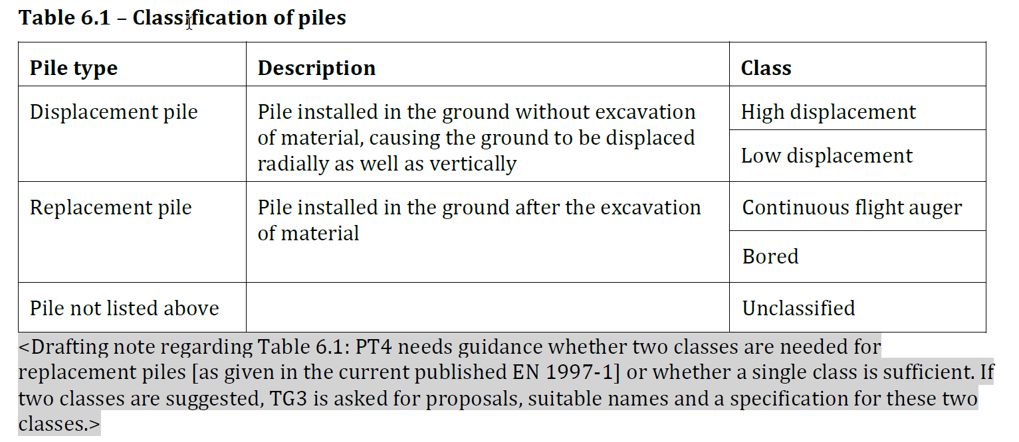
PT4 Final Draft October 2019
Classification of piles

Slide 4
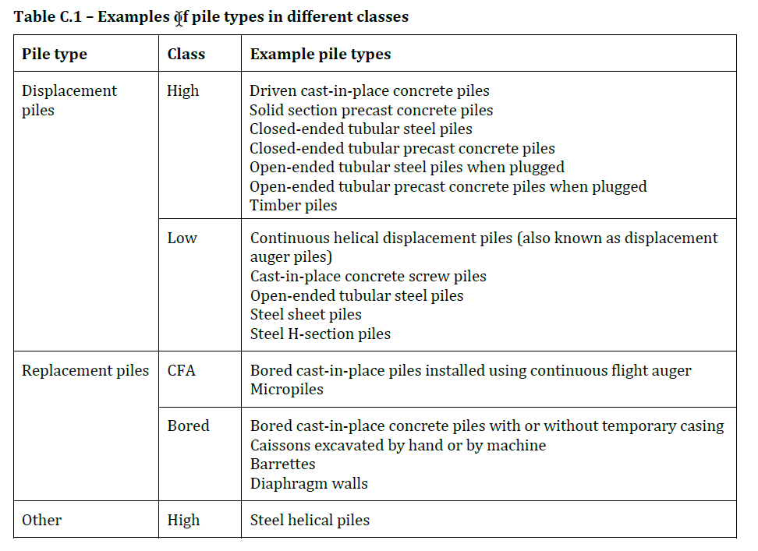
PT4 Final Draft October 2019
Examples of pile types in different classes

Slide 5
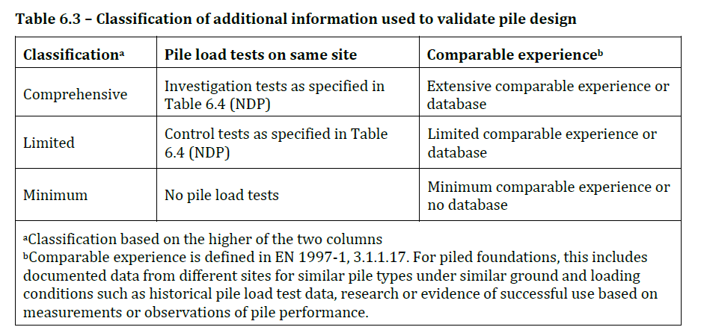
PT4 Final Draft October 2019
Classification of information used to validate pile design

Slide 6
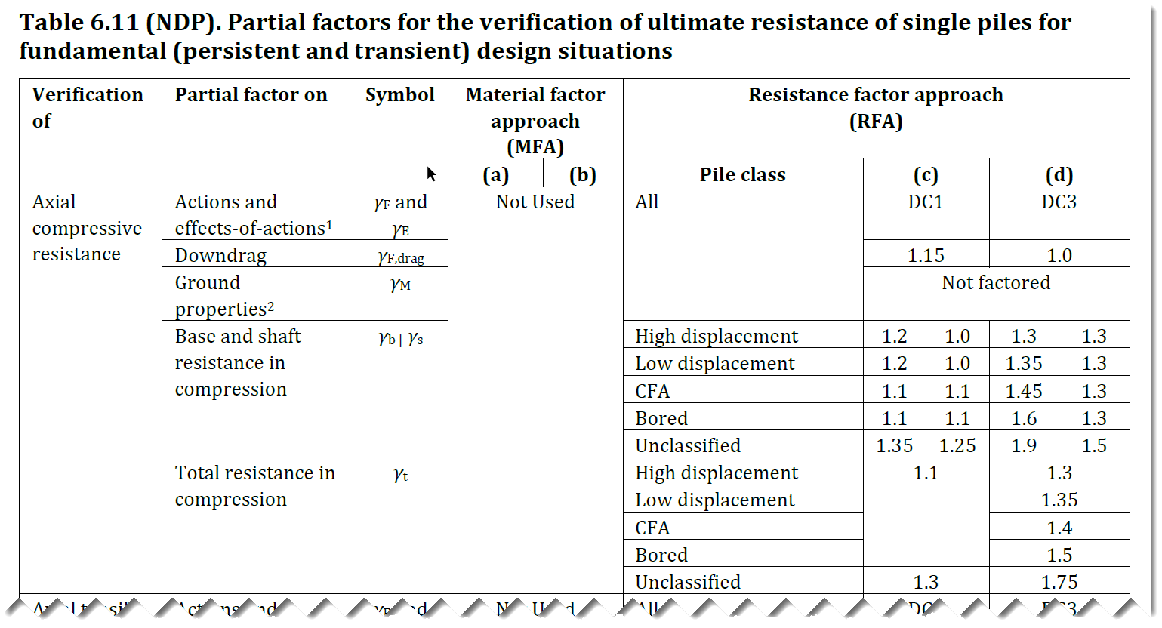
PT4 Final Draft October 2019
Partial factors for pile resistance

Slide 7

PT4 Final Draft October 2019
Pile design by calculation Method A ‘Ground Model Method’
$${ R}_{cd} = \frac{R_{c,rep}}{γ_{t} . γ_{Rd}} or \left(\frac{R_{b,rep}}{γ_{b} . γ_{Rd}}+\frac{R_{s,rep}}{γ_{s} . γ_{Rd}}\right)$$
Option | γ_{G} | γ_{Q} | Independent validation | γ_{Rd} | FoS | Pile type | γ_{t} | γ_{b} | γ_{s}*
(c) DC1 | 1.35 | 1.5 |  |  | ? |  |  | - | -
(d) DC3 | 1.0 | 1.3 | Minimum | 1.8 | 2.7-3.3 | Bored CFA Low displacement High displacement | 1.5 1.4 1.35 1.3 | 1.6 1.45 1.35 1.3 | 1.3 1.3 1.3 1.3
 |  |  | Limited | 1.55 | 2.3-2.9
 |  |  | Comprehensive | 1.3 | 1.9-2.4

Slide 8

Pile design by calculation Method A ‘Ground Model Method’
Alternative based on DC1
$${ R}_{cd} = \frac{R_{c,rep}}{γ_{Rc} . γ_{Rd}} or \left(\frac{R_{b,rep}}{γ_{Rb} . γ_{Rd}}+\frac{R_{s,rep}}{γ_{Rs} . γ_{Rd}}\right)$$
Option | γ_{G} | γ_{Q} | Independent validation | γ_{Rd} | FoS | Pile type | γ_{Rc} | γ_{Rb} | γ_{Rs}
(c) DC1 | 1.35 | 1.5 |  |  | ? |  |  | - | -
(d) DC1 | 1.35 | 1.5 | Minimum | 1.6 | 2.5-3.2 | Bored CFA Low displacement High displacement | 1.4 1.4 1.3 1.2 | 1.4 1.4 1.3 1.2 | 1.2 1.2 1.1 1.1
 |  |  | Limited | 1.4 | 2.2-2.8
 |  |  | Comprehensive | 1.2 | 1.9-2.4

Slide 9
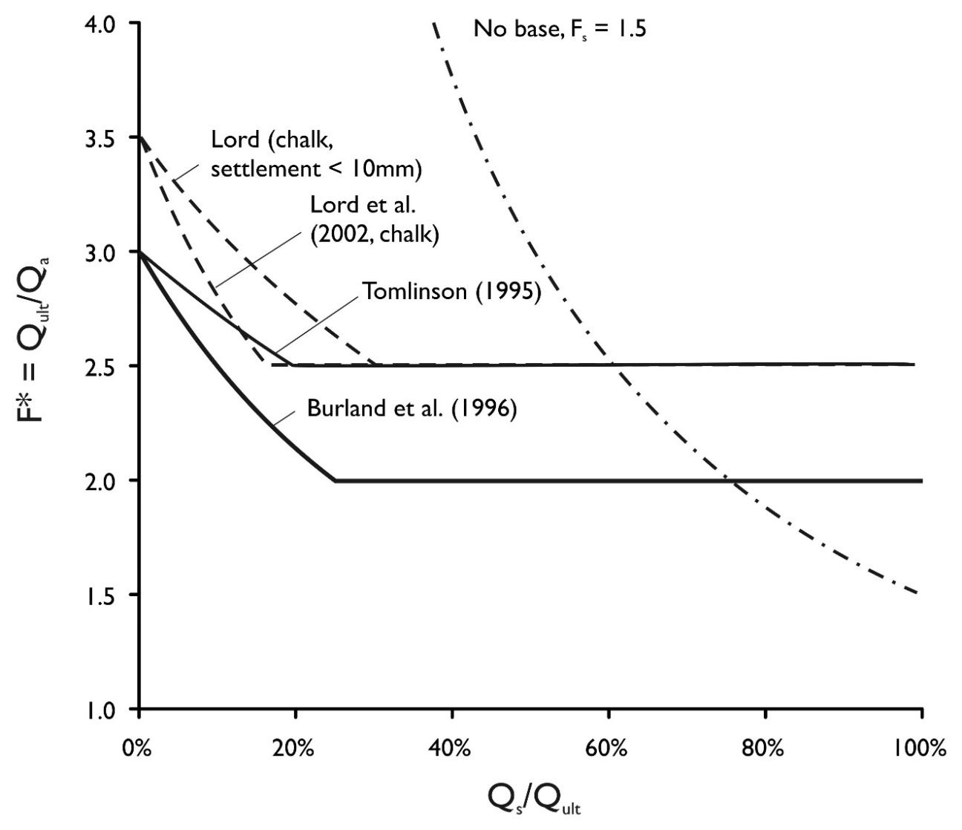
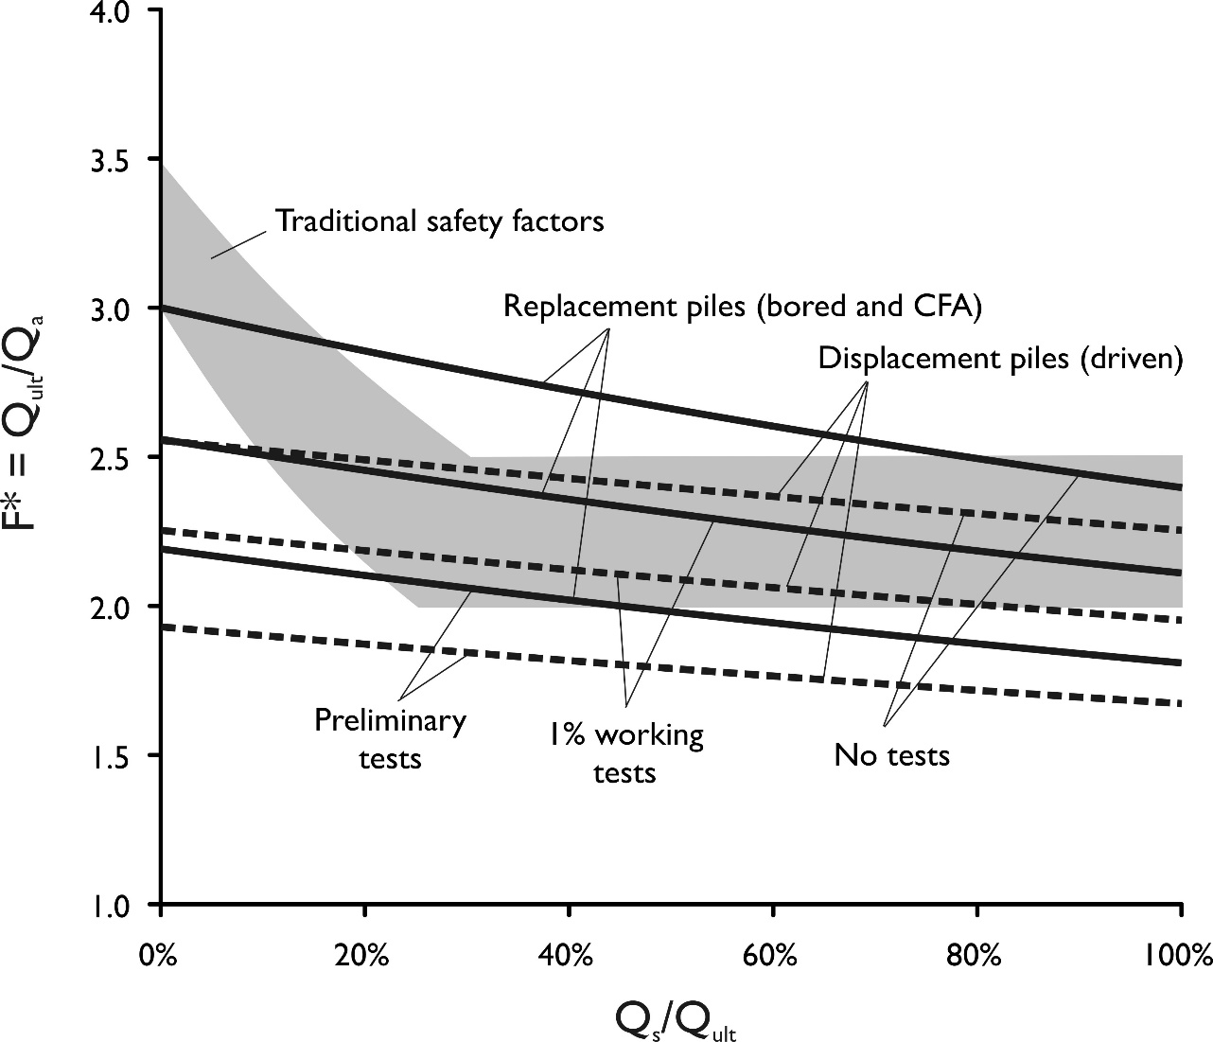
Traditional factors-of-safety vs Eurocode 7 UK NA
Bond and Harris (2008) †

Slide 10
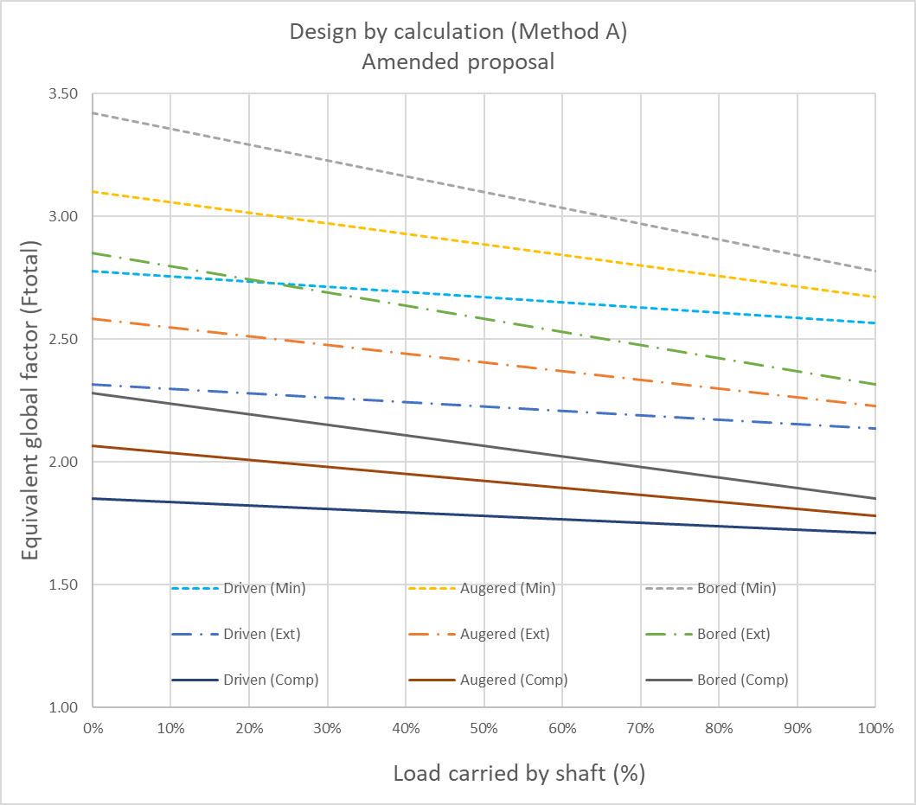
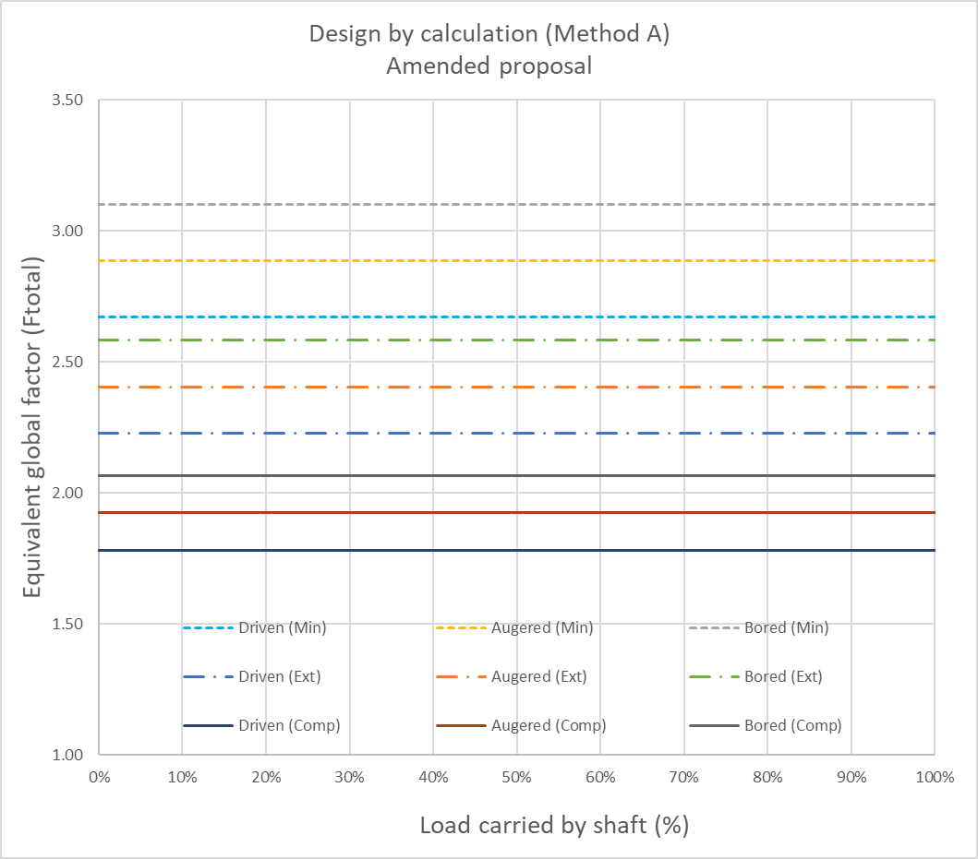
Global FoS with amended new proposal (50% G + 50% Q)
(left) Base and shaft factors (right) Total factor

Slide 11
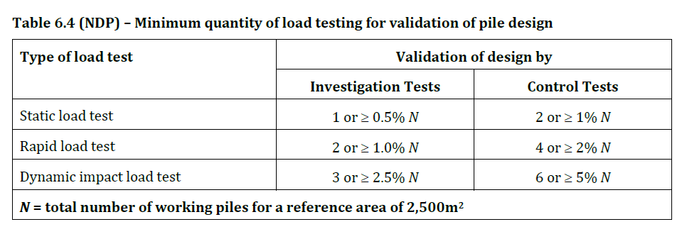
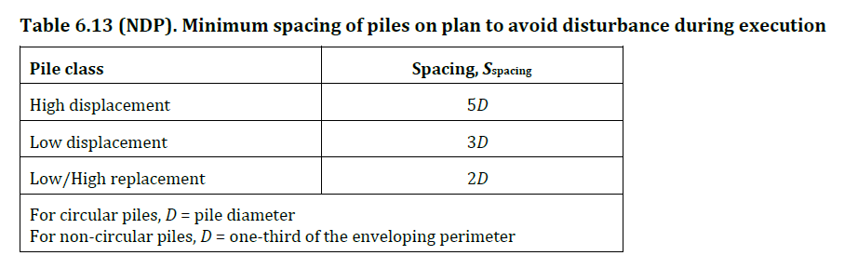
PT4 Final Draft October 2019
Minimum validation testing/minimum pile spacing

Slide 12
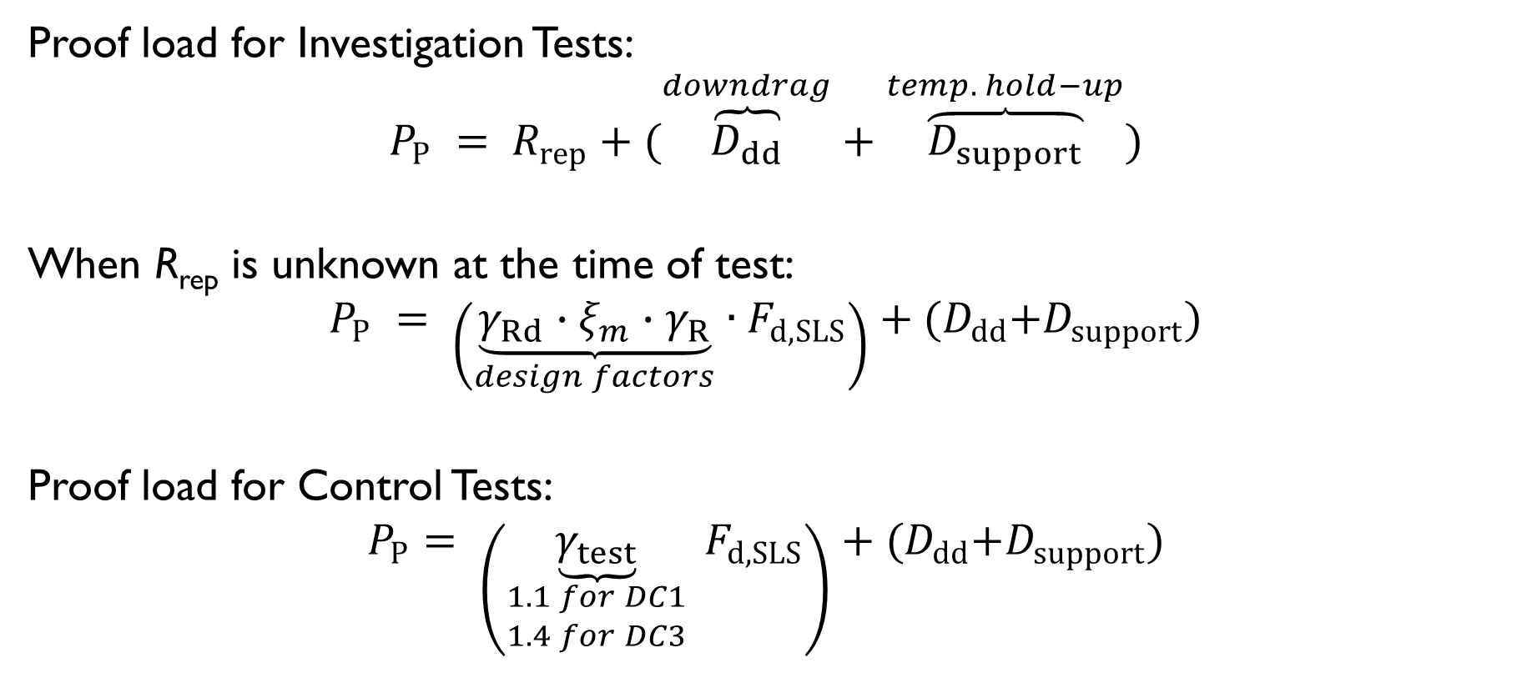
PT4 Final Draft October 2019
Test proof load
Proof load for Investigation Tests:
$$P_{P} = R_{rep}+(\overset{downdrag}{\overbrace{D_{dd}}}+\overset{temp. hold−up}{\overbrace{D_{support}}})$$
When R_{rep} is unknown at the time of test:
$$P_{P} = \left(\underset{design factors}{\underbrace{γ_{Rd}∙ξ_{m}∙γ_{R}}}∙F_{d,SLS}\right)+{(D}_{dd}+D_{support})$$
Proof load for Control Tests:
$$P_{P}= \left(\underset{\begin{aligned}1.1 for DC1 \\ 1.4 for DC3\end{aligned}}{\underbrace{γ_{test}}} F_{d,SLS}\right)+{(D}_{dd}+D_{support})$$

Slide 13
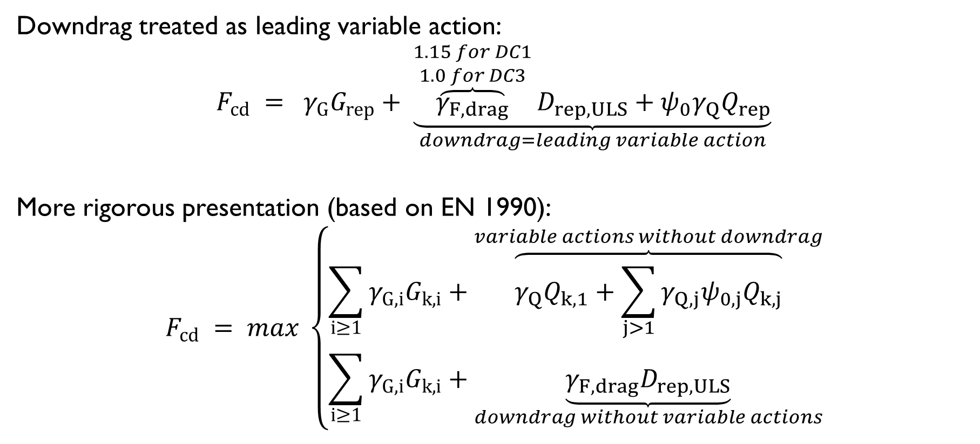
PT4 Final Draft October 2019
Combination of actions for downdrag – guidance requested!
Downdrag treated as leading variable action:
$$F_{cd} = γ_{G}G_{rep}+ \underset{downdrag=leading variable action}{\underbrace{\overset{\begin{aligned}1.15 for DC1 \\ 1.0 for DC3\end{aligned}}{\overbrace{γ_{F,drag}}}D_{rep,ULS}+ψ_{0}γ_{Q}Q_{rep}}}$$
More rigorous presentation (based on EN 1990):
$$F_{cd} = max \left\{\begin{matrix}\sum_{i≥1}{γ_{G,i}G_{k,i}}+\overset{variable actions without downdrag}{\overbrace{γ_{Q}Q_{k,1}+\sum_{j>1}{γ_{Q,j}ψ_{0,j}Q_{k,j}}}} \\ \sum_{i≥1}{γ_{G,i}G_{k,i}}+\underset{downdrag without variable actions}{\underbrace{γ_{F,drag}D_{rep,ULS}}}\end{matrix}\right.$$

Slide 14
Existing UK pile design practice

Slide 15
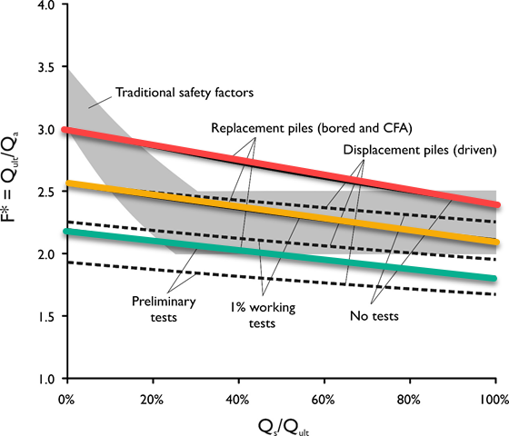
Traditional factors-of-safety vs Eurocode 7 UK NA
Bond and Harris (2008) †

Slide 16
Pile design by calculation Method A ‘Ground Model Method’
Alternative based on DC1 – CFA/Bored piles only
$${ R}_{cd} = \frac{R_{c,rep}}{γ_{Rc} . γ_{Rd}} or \left(\frac{R_{b,rep}}{γ_{Rb} . γ_{Rd}}+\frac{R_{s,rep}}{γ_{Rs} . γ_{Rd}}\right)$$
Option | γ_{G} | γ_{Q} | Independent validation | γ_{Rd} | FoS | Pile type | γ_{Rc} | γ_{Rb} | γ_{Rs}
(c) DC1 | 1.35 | 1.5 |  |  | ? |  |  | - | -
(d) DC1 | 1.35 | 1.5 | Minimum | 1.6 | 2.6-3.2 | Bored/CFA | 1.4 | 1.4 | 1.2
 |  |  | Limited | 1.4 | 2.3-2.8
 |  |  | Comprehensive | 1.2 | 2.0-2.4

